Slide 1

CHARACTER COUNTS! 6.0
Student Development Workshop
Day 3

Slide 2

Good Morning! Please read this slide as we start our day . . . ☺
At your table you will find a sentence strip. Please write on the sentence strip a “slogan,” “phrase,” or “thought” that has been significant for you during the previous two days. Think of what might go on a “bumper sticker” for someone’s car.
Notes:
Ethics in Public Administration
(c)2006 Josephson Institute
2

Slide 3
Ways to Instill Beliefs
Day 2
Direct Teaching
Experiential Learning
Vicarious Experiences
Connection to Academic Curriculum

Slide 4
Dialogue
What are the Six Pillars and the Six Success Skills?
What is T.E.A.M. and how is it integrated into a school?
Discuss Decision-Making (Stakeholders)
CHARACTER COUNTS! 6.0 Presentation
The Impact of a Positive School Climate
REFLECTION
What did you learn as the one doing the presentation? As a listener?
Are there ideas you can use in your school?
How can you use a presentation with others in your school or organization?
Notes:
Have participants move into the groups that were formed for the homework presentation and deliver their presentations.
Take notes and try to firm these up during the third day.
Objectives:
Encourage group involvement in understanding the content of the previous two days
Demonstrate the effectiveness of self-assessment rubrics. Point to the Teacher tools section on the website where they can find more of these they can use in their classrooms.
Gives the trainer an opportunity to see where gaps in knowledge are

Slide 5
Module 11
Implementation Strategies
Notes:
Show slides you have created that demonstrate a success story in a setting you are familiar with.
Show these as a separate slide show.
Detail the actions taken by the individuals involved to achieve successful outcomes.
Structure the presentation as follows:
1. Vision: what were the goals set out in the vision?
2. Stakeholders: who were involved in reaching the goals? What roles did they play in achieving success?
3. Steps: was training part of the plan? What activities (such as curriculum integration, setting up teams, outreach, etc) were part of the action steps?
4. Success: How was success measured?
Choose one of the videos from the CC! site to play.

Slide 6
Video Lesson
What’s Happening at an Elementary & Middle School
Notes:
The video link was active at the time of the seminar. Please understand that links can change or no longer be active.
Video found at: https://www.youtube.com/watch?v=HuxejhBOCOo

Slide 7
Video Lesson
What’s Happening at a High School
Notes:
The video link was active at the time of the seminar. Please understand that links can change or no longer be active.
Video found at: https://www.youtube.com/watch?v=HuxejhBOCOo

Slide 8
How to Build classrooms that promote academics, social/emotional learning and character
Create awareness of the academic, social and emotional and character beliefs by using visual displays, and being intentional and explicit teaching with instructional strategies and free-standing lessons
Intentionally teach academics and character at the same time
Connect with colleagues to promote a positive learning environment where CHARACTER COUNTS! becomes part of the DNA of a school or program
Practice character-based discipline in managing behaviors
Provide opportunities to help students make effective and ethical decisions
Strive to build relationships with students and model character
Communicate with parents
Pages 59-61
Notes:
Refer to Pages 72-74 in the Training Workbook that will elaborate on each of the key points.
The slides that follow will provide implementation strategies for the school and classroom.

Slide 9
Settings for School Impact
School-Wide Activities
Classroom Activities
Co-Curricular & Sports

Slide 10
An Effective CHARACTER COUNTS! Initiative is …
Purposeful
Pervasive
Repetitive
Consistent
Creative
Concrete
P
P
R
C
C
C

Slide 11
PPRCCC
Purposeful – clear objectives with understanding of why character is important.
Pervasive – Pervade all aspects of school life.
Repetitive – Messages about meaning and importance of the values and traits should be frequent and explicit.
Consistent – Attitudes, words and actions must be consistent and supportive of the desired behaviors.
Creative – Teachers need to engage students in active learning using a variety of instructional methods.
Concrete – The desired values and skills must be expressed in the context of relevant situations.

Slide 12
School-Wide Messaging
Marquee messages
Announcements
Calendars, notices and flyers
Banners, murals, hallway walls
Cafeteria and Auditorium
Playground, Gymnasium
School buses

Slide 13
School-Wide Activities
8. Theme Assemblies
9. Rewards, Awards, Prizes
10. Contests
11. Ceremonies and Rituals
12. Pride Campaign
13. “Six Pillars” Clubs
1. Word of the Month/Week
2. Morning Announcements
3. Daily/Weekly Quotations
4. Hallway and Door Displays
5. School Mural
6. Mottos/Slogans
7. Library Exhibits & Booklists

Slide 14
School-Wide Activities
20. School Service Projects
21. Student-Designed T-shirts
22. Pledges, Codes and Rules of Conduct
23. Peer Counseling/Mentoring
19. Cross-Age Tutoring
18. Community Service Projects
17. Fund-Raising for Charities
16. Recognition Wall
15. “Honor” Roll (non-academic)
14. CC! Student Newspapers

Slide 15
:
School-Wide Activities - Quotations
Start each day or week with a selected quotation and an essay assignment or brief discussion:
Selected by principal, teachers or students Found at: www.whatwillmatter.com
Original quotes/slogans/bumper stickers written by students
Use of CC! Instructional Resources – Today Counts, Way To Go

Slide 16
Schoolwide Activity
Professional development opportunities conducted on a regular basis by school champions
Parent Meetings/Workshops
An organized CHARACTER COUNTS! Committee or Team
Student/Faculty Task Force

Slide 17
Hallways and doors
Murals
Displayed with a wide array of professional or student drawn posters, drawings, montages, etc. that reflect the messages of CHARACTER COUNTS! and celebrate student goals and achievements.
Students can adorn large public areas and main entryways with permanent or temporary (on paper or plywood) murals with CHARACTER COUNTS! themes.

Slide 18
Mottos
Library Exhibits/Booklists
Students can propose and select school-wide and class level (e.g., 10th grade) mottos and slogans to articulate and reinforce CHARACTER COUNTS! messages.
Designate special areas for books related to one or more of the Six Pillars.
Create a “role models” display with books on people (e.g., Martin Luther King, Mother Teresa, Gandhi, Cesar Chavez, Helen Keller, etc.) whose lives demonstrate(d) good character.

Slide 19
Theme Assemblies
Conduct school assemblies focusing on a theme related to character development. Community members might be invited to speak about one or more of the Six Pillars. Students might also perform skits, deliver speeches and participate in debates/discussions.
Awards
Recognize and reinforce behavior that shows good character by holding “Good Character” award programs.

Slide 20
Contests
Focus on one or more of the Six Pillars or other SEL or Academic values.
Essay or speech contests
Art contest with winning entry printed on bumper stickers, T-shirts, etc.
Fundraising contests with proceeds benefiting an organization that advances a given Pillar.
Recognition
Periodically have students nominate their peers using criteria based on the Six Pillars of Character. Frame and retain the photos on a specially designated wall.

Slide 21
Cafeteria Table Tents
Have students design small folded cards with quotes, ethical dilemmas or other messages about character. Place these on cafeteria tables and encourage everyone to discuss them at lunchtime.
“6 Pillar Success Clubs”
Organize “6 Pillar Clubs” — one for each Pillar and Success Skill— and have the students plan and organize relevant activities associated with CHARACTER COUNTS!.

Slide 22
School or Community Projects
Peer Mentoring
Public Area Beautification: Help students organize and carry out a cleanup of a park or playground.
Authorized “Six Pillars” Anti-Graffiti Wall: Organize students and paint a mural focusing on good character on a wall in the community.
Designate young people to serve as peer counselors and mentors. Incorporate the Six Pillars into their training.
Arrange for middle and high school students to counsel and tutor younger children.

Slide 23
IDEAS I CAN USE AT MY SCHOOL
Page 63

Slide 24
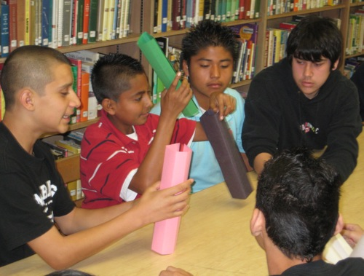
Classroom Activities
Problem Based Learning or class projects
Class discussions using CC! instructional resources
Classroom rules developed and ratified by students
Reinforcement techniques — praise for effort, approval, correction with high expectations
Use of vicarious experiences or experiential activities

Slide 25

Classroom Discussions
Connection to academic content and with reading or writing assignments, social studies, etc.
National or local news events
Discussion questions included with CC! Resources – Today Counts or Way To Go
Use of CC! free lesson plan bank
School rules and procedures
Morning or classroom meetings

Slide 26

Students consider and express their thoughts regarding the ethical or character aspects of some issue in the form of:
SM
1. Literature commentaries (books/stories)
2. Writing personal essays or journaling
3. Delivering speeches
5. Crafting personal mission statements
4. Setting short-term on long-term goals

Slide 27

Individual or Group Projects
Cartoons and posters
Original quotations
Picture book for children
Songs, skits, plays and videos
Writing character commercials
Journalistic-style interviews

Slide 28
Instructional Methods
Direct teaching
Cooperative learning
Guest speakers/instructors
Small group discussion
Videos
PPT slide presentation
Case studies
Experiential Activities
Surveys
Role-playing

Slide 29
Morning Meeting Ideas
One minute greeting – walk around, shake hands and say good morning.
Share - best thing you did this weekend, favorite movie, book or TV show and why.
Discuss classroom key beliefs and choices that will impact behavior.
Observation skills - What did you notice?
Present a quote to discuss, or review a story read or a video clip viewed with connections to character and choices.

Slide 30
IDEAS I CAN USE IN MY CLASS:
Page 65

Slide 31
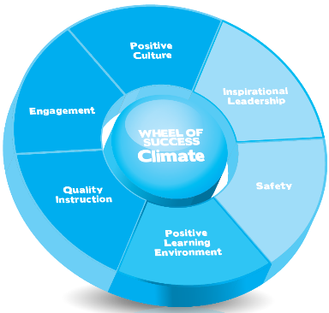
School Climate
Positive Culture – List at least two specific actions to achieve each element
SC1.1
SC1.2
SC1.3
SC1.4
SC1.5
SC1.6
SC1.7
Welcoming and accessible
Respectful and supportive relationships
Clear, fair and consistently implemented rules and policies
High expectations and standards (culture of excellence)
Growth mindset
Participatory decision-making
High staff morale
Worksheet 17 – Page 67

Slide 32
School Climate
Engagement - List at least two specific actions to achieve each element
SC2.1
SC2.2
SC2.3
SC2.4
Parent involvement
Student engagement
Staff consensus and commitment
Administrator presence and participation
SC2.5
Professional development opportunities
Page 68

Slide 33
School Climate
Quality Instruction - List at least two specific actions to achieve each element
SC3.1
SC3.2
SC3.3
SC3.4
SC3.5
Effective instructional strategies
Collaboration with colleagues
Proactive interaction with parents
Useful and productive student assessments
Feedback and accountability
Page 69

Slide 34
School Climate
Inspirational Leadership - List at least two specific actions to achieve each element
SC4.1
SC4.2
SC4.3
SC4.4
SC4.5
Inspires commitment to vision
Establishes a strategic plan
Effective and efficient management
Trust and confidence of constituents
Regular communication
Page 70

Slide 35
School Climate
Safety & Positive Behavior - List at least two specific actions to achieve each element
SC5.1
SC5.2
SC5.3
SC5.4
SC5.5
Practical and effective disciplinary rules, policies and strategies
Emergency preparedness
Detect and deal with weapons, drugs and alcohol
Prevention of dangerous physical conditions
Security regarding outside threats
Page 71

Slide 36
School Climate
Positive Learning Environment - List at least two specific actions to achieve each element
SC6.1
SC6.2
SC6.3
SC6.4
Attractiveness and maintenance of physical plant
Instructional areas conducive to learning
Adequate physical space in classrooms
Adequate resources for instruction and co-curricular activities
SC6.5
Assessment of the learning environment
Page 72

Slide 37
Indicators of a Positive School Climate
Positive Culture Engagement
Quality Instruction Inspirational Leadership
Safety & Positive Behavior Positive Learning Environment
Indicator | Key attributes that apply to our school | Action steps our school could take as part of a CHARACTER COUNTS! initiative
Culture
Engagement
Quality Instruction
Inspirational Leadership
Safety & Positive Behavior
Positive Learning Environment
Page 73

Slide 38
Sphere of Influence
Three areas of impact:
personal (own life)
professional (within the sphere of your work)
some influence (areas you don’t control, but can influence those who do)
On post-it notes, write an impact you can make in each of the three areas.
Use this as a tool for getting ideas from others in your constituency.
Worksheet 18 – Page 74
Refer to TRAINING WORKBOOK Pages 74-75 for ideas.
Stick your post-its in the appropriate area on the sheet.

Slide 39
What are the positive things we are already doing related to teaching, enforcing, advocating and modeling character that promotes a positive school climate?
Considering all that we already do effectively, what specific strategies should we consider doing that will enhance your school’s or program’s character development efforts?
TEACH | ENFORCE | ADVOCATE | MODEL
TEACH | ENFORCE | ADVOCATE | MODEL
Worksheet 19 – Page 76

Slide 40
Module 12
Work of a CHARACTER COUNTS! Team
Lead
Plan
Implement
Monitor
Evaluate
Sustain
… your initiatives
Notes:
Tasks of a CHARACTERCOUNTS! Team
Determine specific goals:
What do you want to accomplish?
What behaviors do you want to see more of and less of?
What will it look like when you reach your goal?
How will you monitor your progress?
Agree to be purposeful in your approach with clear objectives that influence values and behavior.

Slide 41
Data
Conduct a needs (climate) assessment and gather baseline data. Evaluate program and adjust accordingly.

Slide 42
Collect Information
Survey what your school, organization, or community is doing to encourage good character.
Assess the needs of the school, organization, or community, using surveys, focus groups, and other tools.

Slide 43
Prepare for Assessment
WHO
WHAT
WHEN
HOW
should be surveyed
questions
to ask
time of year
online, focus group, or paper and pencil
Notes:
Involve students and other stakeholders. Plan it carefully. Make sure to include interim collection as part of the planning.

Slide 44
Develop Baseline Statistics
Collect other statistics from:
  Police: graffiti, drug and alcohol use, vandalism, petty thefts
  School Discipline Records: referrals, detentions, tardies, absences, suspensions
  Academic Records: standardized test scores, overall grade-point averages by grade and subject, rates of late and incomplete homework
Review Data Management Report - Addendum
Notes:
Examples of data.

Slide 45
Measuring Impact
CHARACTER COUNTS! Works
Define success – start with the end in mind. What specific attitudes and behaviors are you trying to change?
What are the measurable markers (i.e., evidence) of the change?
How much change is needed to justify the effort?

Slide 46
Benefits of Evaluation
The benefits are many because your initiative will be able to:
Prove its effectiveness
Persuade influential entities to endorse the program
Convince others to adopt or keep the program and help it expand
Secure renewable sources of funding more easily
Identify its strengths and weaknesses for continual improvement
Encourage and recharge everyone involved
Celebrate achievements and recognize exceptional contributions

Slide 47
Types of Data
Quantitative, or “hard” data, focuses on numbers and frequencies and consists of statistics.
Qualitative, or “soft,” “nuanced,” or “contextual” data.
Focuses on words and meanings. Examples of qualitative data are anecdotes and informal observations.
Examples of quantitative data are numbers of discipline referrals, survey scores or test results.

Slide 48
Testimonials
Essays
Participant observation
Focus groups
Unstructured interviews
Collecting Meaningful Data

Slide 49
Downey, California
ACADEMIC PERFORMANCE
HIGHER GRADUATION RATES.
REDUCED SUSPENSIONS & EXPULSIONS
API scores rose 5%, an increase of 63% over the previous 3 years before CC!
Graduation rates have been over 92% since CC implementation; statewide graduation rate is 68%
Suspension days decreased 41% from 6417 to 3757; expulsions fell 64% from 229 to 82.
PARENTS LOVE PROGRAM
TEACHERS SUPPORT
STUDENTS SUPPORT
96% said CC! a valuable part of the school; 94% said, “My child is exhibiting Six Pillars of good character at home and at school.”
96% said, “The content and training they received to implement CHARACTER COUNTS! is useful in helping build students' character”; 95% "would recommend CC! training to others.”
94% agree: "I feel the CC! program makes me a better student;" 95% agree, “The Six Pillars of good character help remind me to make good choices."
Notes:
Demonstrates efficacy of change in the culture of a school. Again, be sure not to spend too much time here, the point is to demonstrate that implementing CHARACTER COUNTS! is an effective vehicle for culture and climate change in schools.

Slide 50
Tulare County, CA
A Comprehensive 3 year study funded by the U.S. Department of Education – 2007-2010
Los Tules Middle
Physical violence (fighting, bullying, intimidation) is a real problem at my school.
Down 29% (from 70% to 41%)
I feel safe at my school.
Up 13% (from 49% to 62%)
2007-08 Baseline | 2009-2010 (YEAR 3)
Notes:
Used racial slurs or insults.
30%
27%
Hit a person because I was angry.
52%
49%
Suffered the prejudice of others.
48%
46%
Mistreated someone because he or she belonged to a different group.
22%
20%

Slide 51
Monte Vista Elementary
Bullied, teased, or taunted someone.
Down 14% (from 44% to 30%)
Mistreated someone because he or she belonged to a different group.
Down 10% (from 15% to 5%)
Used racial slurs.
Down 8% (from 28% to 20%)
Physical violence (fighting, bullying, intimidation) is a real problem at my school.
Down 30% (from 65% to 35%)
Notes:
Copied an Internet document for a classroom assignment.
22% 9% 13% improvement

Slide 52
Tulare Western High
A person has to lie or cheat sometimes in order to succeed.
Down 9% (from 40% to 31%)
Lied to a teacher about something significant.
Down 9% (from 64% to 55%)
Stole something from a store.
Down 7% (from 32% to 25%)
Stole something from parents or relative.
Down 6% (from 22% to 16%)

Slide 53
Tulare Western High
Hit a person because I was angry.
Down 16% (from 54% to 38%)
Bullied, teased, or taunted someone.
Down 14% (from 44% to 30%)
Mistreated someone because he or she belonged to a different group.
Down 10% (from 15% to 5%)
Used racial slurs.
Down 8% (from 28% to 20%)
Notes:
Copied an Internet document for a classroom assignment.
22% 9% 13% improvement

Slide 54
Tulare Western High
It's sometimes OK to hit or threaten a person who makes me very angry.
Down 10% (from 30% to 20%)
Physical violence (fighting, bullying, intimidation) is a real problem at my school.
Down 10% (from 15% to 5%)
I feel safe at my school.
Down 6% (from 56% to 50%)
Notes:
Physical violence (fighting, bullying, intimidation) is a real problem at my school. 40% 56% 5

Slide 55
STAFF PROFESSIONAL DEVELOPMENT
Ongoing Support for School Staff
Notes:
Focus on training experiences

Slide 56
Presentation of CHARACTER COUNTS! by School Champions
Prepare regular professional development presentations on character development and integration
Based upon the allotted time, plan what can be included. Reflect back on your training to determine what would be of greatest benefit for your staff.
Ideally, a full day can be devoted to a CHARACTER COUNTS! presentation.
Notes:
Tips for them if they are to present. No need to go into detail here. They can also reflect on their group presentation activities from earlier in the day. What do they still need to know to present effectively? How can they make the most of the notes they’ve taken and the slides they have? Important to continue to remind them of the importance of notes and slides.

Slide 57
Full Day or Half Day Workshops by CHARACTER COUNTS! Trainers
Introduction to CHARACTER COUNTS!™
Integrating CHARACTER COUNTS!™
Combatting Bullying by Creating a Culture of Kindness
Building a Positive School Climate That's Awesome
Dealing with Attention Disorder and Similar Challenges
Managing Behaviors of At-Risk Youth and their Parents
Using Video Clips or Other Social Media While Teaching
Instilling Self-Confidence and Building Resilience
Notes:
Examples of ½ to one day workshops that JI can present for a school.

Slide 58
Full Day or Half Day Workshops by CHARACTER COUNTS! Trainers
Creating a Professional Learning Environment for Teachers
The TEAM Method of Teaching Character
A Positive Learning Framework for Class Management
Getting the Most and Best from Parents
Applying Growth Mindset in Your School
Integrated Approach to Teaching Responsible Citizenship
Pursuing Victory with Honor
Notes:
Examples of ½ to one day workshops that JI can present for a school.

Slide 59
Create a Vision and Action Plan
Review the goals you had for this workshop. Do they reflect the desired action plan goals for this coming school year?
Include in your plan the components of an effective CC! initiative from the CHANGE CHART.
Review ASSESSING YOUR CC! INITIATIVE (Page A-24)
Vision
Commitment
PD – When? Who? How What?
Assessment – See Addendum
Resources – Purchased? Using existing resources? Prepare from the Training Workbook?
Access resources on Graduate Portal

Slide 60
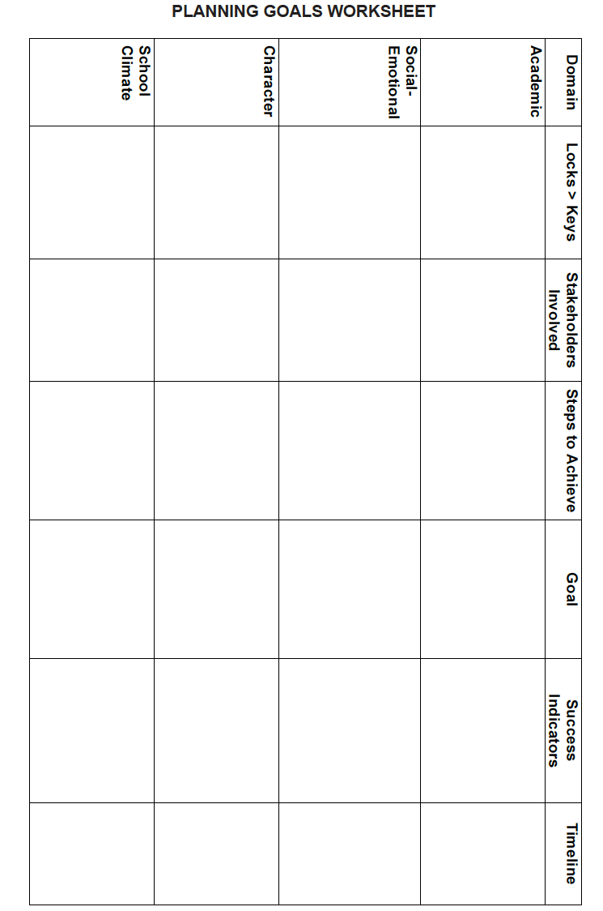
Notes:
Use either this slide or the next to help participants in action planning.

Slide 61






Goal: Making Sure CHARACTER COUNTS!®
1. What would you like to happen? VISION
What will CC! look like in our program?
COMMITTEE
COMMITMENT
RESOURCES
4. At the end of this year, we will have done these 3 things:
Describe the current situation in comparison to the goal.
6. How will we measure effectiveness of CC!
ASSESSMENT
5. The first steps we will take:
Notes:
These are key items for the group to consider when implementing the program.

Slide 62
Ideas to Action
Engaging Parents - Character Building Begins at Home
CHARACTER COUNTS!® programs are designed to supplement and enhance, not substitute for, family efforts to instill positive ethical values and good character.

Slide 63
How Parents Can Promote Trustworthiness
Provide for their basic needs on a consistent basis (love, proper nutrition, healthy activities, reading for enjoyment, etc.).
Develop a calm, emotionally responsive, and stable home environment, with a proper balance of freedom and structure.
Develop family rules and consequences in a preventative manner and use consistent discipline to educate.
If applicable, model a marital or partner relationship that demonstrates honesty, integrity, promise-keeping, and loyalty.

Slide 64
How Parents Can Promote Respect
Treat your youngster with respect, and insist on respectful treatment from your child.
Insist that your child treats everyone with respect and models respectful behavior at all times.
Model good manners.
Embrace diversity by respecting reasonable social customs of others.
Respect privacy unless suspicious behaviors necessitate otherwise.

Slide 65
How Parents Can Promote Responsibility
Give their youngsters tasks at home to accomplish.
Focus on effort and a positive attitude rather than over-emphasizing outcome.
Applaud courageous social behaviors when your child avoids temptations.
Insist that they take ownership for their own mistakes.
Develop high expectations and link consequences to poor choices.
Emphasize the importance of education, role-modeling, and self-control.

Slide 66
How Parents Can Promote Fairness
Create a family environment that provides opportunities for each family member to express opinions and participate in decisions.
Embrace the uniqueness of each family member, avoiding comparisons with siblings and friends.
Clearly state and consistently apply rules and procedures.
Teach open-mindedness as well as consistency.
Talk frequently about fairness and fair play.
Treat others, both inside and outside the family, equitably.

Slide 67
How Parents Can Promote Caring
Demonstrate love and affection. Give time, attention, and praise.
Encourage the awareness of and expression of feelings.
Teach children to think of the impact their conduct will have on others.
Encourage and model caring, empathy, charity, and service to others.

Slide 68
How Parents Can Promote Citizenship
Develop a family mission and values statement that includes commitment to the Six Pillars of Character.
Encourage cooperation, teamwork, and service to others.
Model citizenship. Respect authority, obey the rules, and look for opportunities to make a contribution.
Control the behavior of your children to assure they do not disturb others in public places.
Keep in mind that a healthy community starts with your family.

Slide 69

Ideas to Action
Sports

Slide 70
CHARACTER COUNTS!® Sports
Believing that sports presents a uniquely powerful tool for building and demonstrating character, the CHARACTER COUNTS!® Coalition founded CHARACTER COUNTS!® Sports in 1999.

Slide 71
Sources of Enjoyment in Sports
Loving the Game – Physical activity, challenge, and camaraderie
Pride and Self-Confidence – Sense of accomplishment in learning, getting better, developing skills, and achieving personal bests
Competition – Intrinsic pleasure in competition, comparing skills to others
Winning – Pride, sense of accomplishment, and self-importance

Slide 72
Developing Positive Life Skills
A central goal of youth sports programs should be to help athletes develop positive life skills that will help them become personally successful and socially responsible.

Slide 73
Building Character Through Sports
Establish and enforce rules of conduct.
Hold pre-season parent meetings.
Include issues of ethics, sportsmanship, and character in practices and game-related instruction.
Train and empower game officials.
Give character or sportsmanship awards.
Use CC! logo and Six Pillar language.

Slide 74
Building Character Through Sports
Establish rules of conduct and stated expectations for:
Players
Parents
Coaches
Officials
Hold Pre-season parent meetings
Introduction to CHARACTER COUNTS!® and the Six Pillars
Signed pledges of support
Formation of Parents Council

Slide 75
Building Character Through Sports
Promote CHARACTER COUNTS! with players
Game-related instruction
Short (5-10 minute) discussion during practice
Post-game rituals and celebrations
Post-game re-cap
Game/season character awards
On-field, formal endorsement of the Six Pillars:
Uniforms (patches, pins, etc.) CHARACTER COUNTS!® logo
Team banners
Scoreboard

Slide 76

SIX PILLAR SHUFFLE
We have Pillars one through six
We like to dance and do some tricks.
Follow along and you will see
How fun the Six-Pillar Shuffle can be!
Twist is for Trustworthiness
Roll is for Respect
We're gonna Reach up for Responsibility
Blow a kiss for Caring
Flap your arms for Fairness
Stomp your feet for Citizenship
The Six-Pillar Shuffle is a Kick! https://www.youtube.com/watch?v=IobiqLCoPko

Slide 77
WHAT WILL MATTER
By Michael Josephson © 2003
Ready or not, some day it will all come to an end.
There will be no more sunrises, no minutes, hours or days.
All the things you collected, whether treasured or forgotten will pass to someone else.
Your wealth, fame and temporal power will shrivel to irrelevance.
It will not matter what you owned or what you were owed.
Your grudges, resentments, frustrations and jealousies will finally disappear.
So too, your hopes, ambitions, plans and to do lists will expire.
The wins and losses that once seemed so important will fade away.
It won't matter where you came from or what side of the tracks you lived on at the end.
It won't matter whether you were beautiful or brilliant.
Even your gender and skin color will be irrelevant.
So what will matter? How will the value of your days be measured?
What will matter is not what you bought but what you built, not what you got but what you gave.
What will matter is not your success but your significance.
What will matter is not what you learned but what you taught.
What will matter is every act of integrity, compassion, courage, or sacrifice that enriched, empowered or encouraged others to emulate your example.
What will matter is not your competence but your character.
What will matter is not how many people you knew, but how many will feel a lasting loss when you’re gone.
What will matter is not your memories but the memories that live in those who loved you.
What will matter is how long you will be remembered, by whom and for what.
Living a life that matters doesn't happen by accident.
It's not a matter of circumstance but of choice.
Choose to live a life that matters.

Slide 78
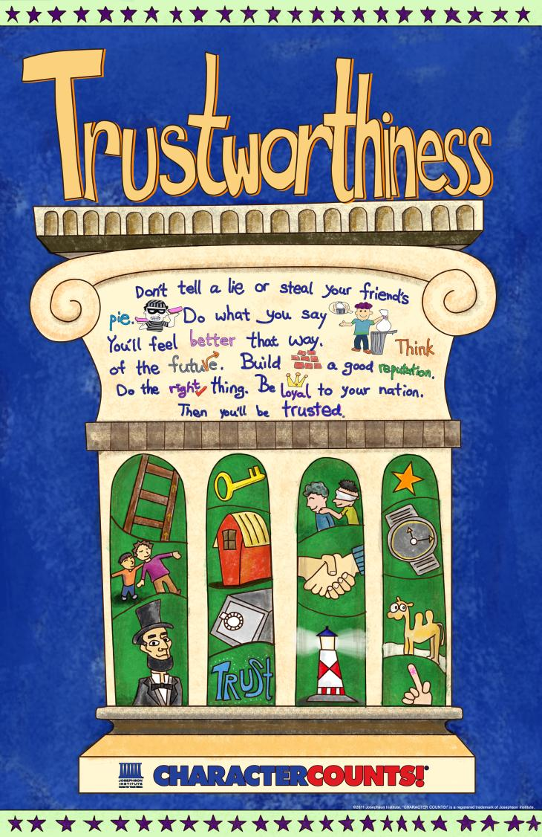

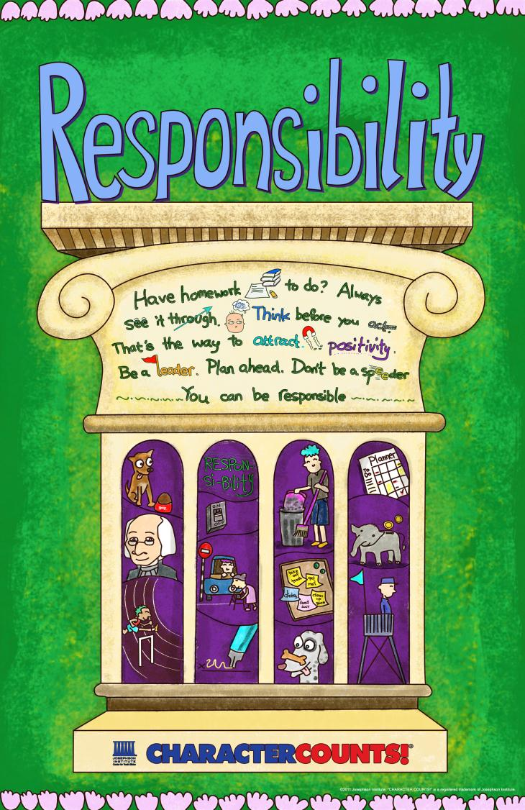


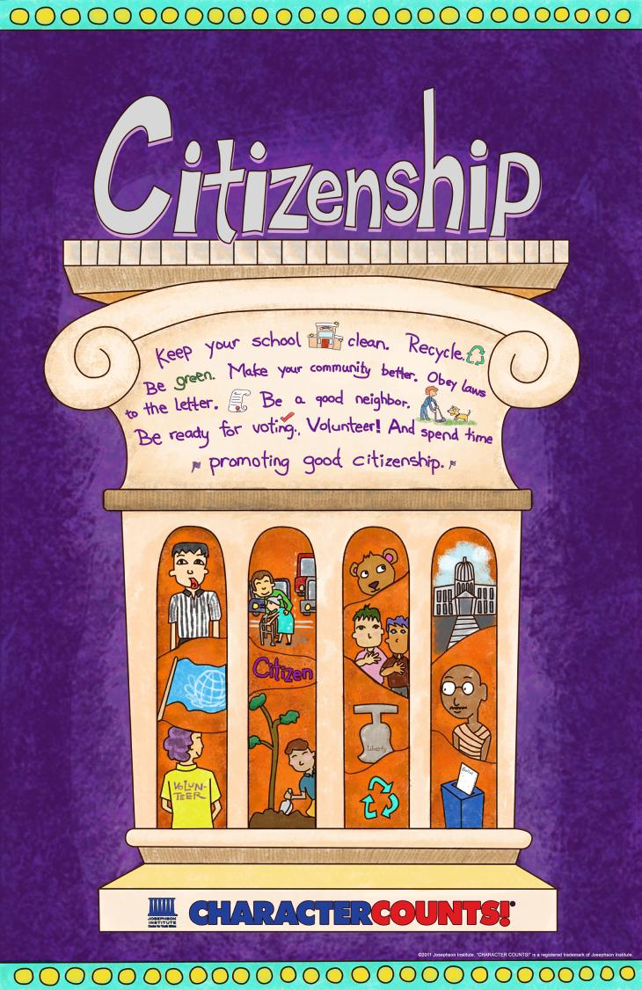
CHARACTER COUNTS!
Everywhere, All the Time…
Thank You!

Slide 79

CHARACTER COUNTS! is a project of
CHARACTER COUNTS! and the Six Pillars of Character
are trademarks of the Josephson Institute.

