Slide 1
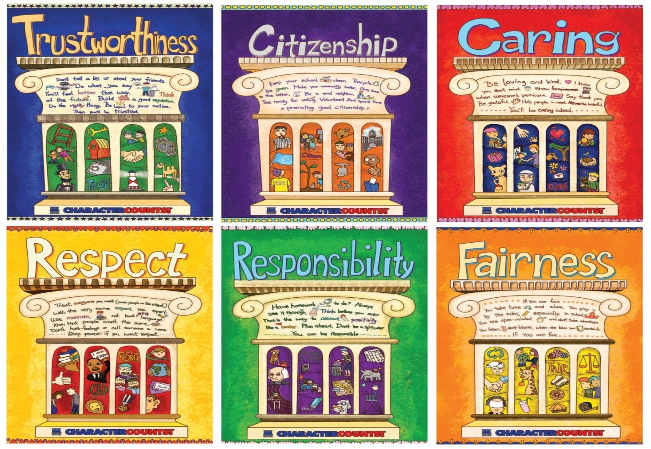
CHARACTER COUNTS! 6.0
Student Development Workshop
Day 2

Slide 2
Opening Activity
Personal Attributes
At the tables you will find papers with descriptive words of personal attributes. What are five attributes that best describe the students you work with? Put a sticker on those five.
On Worksheet 9, page 26 of your Workbook, answer the following questions related to the personal attributes you see in your students or those you possess:
What is the best way to teach these attributes? Can you think of a way you might integrate this attribute within an academic lesson plan?
What are strategies you could initiate to eliminate the negative attributes?

Slide 3
Ways We Instill Beliefs - Day 1
Direct Teaching
Experiential Learning
Vicarious Experiences
What did you learn that you didn’t expect?
How can you use this in your role within your school?
Page 26

Slide 4
MODULE 6
Values, Key and Lock Beliefs
The essence of CHARACTER COUNTS! 6.0 is explicit and overt identification and teaching of the key beliefs (values) that will result in choices that produce desired behaviors.

Slide 5
What are they?
Why do they matter?
Values are beliefs, attitudes and desires that shape goals and motivate choices.
Notes:
Values are essentially beliefs, which, depending on the importance we attach to them , can be described as convictions (usually, these are the most deeply held beliefs evoking passion), attitudes (often reflecting emotions and feelings), opinions and preferences.
A person’s most important beliefs (sometimes different than they think or say) drive behaviors but not always on a conscious level. One of the most effective ways to change behavior is to change beliefs.
Many of our values were formed and reside at a subconscious level , the result of generally held social norms (i.e., culture), religious training, and the teaching and modeling of parents, teachers and peers,
Our values both shape and reflect emotional responses induced at a spontaneous or subconscious level as well as the result of conscious deliberative reasoning.
Most people are unaware of all the beliefs that shape their attitudes and actions.
The beliefs that have the most influence on behavior are not necessarily true. Many are irrational (not the result of reasoning), some are illogical, some are mere superstitions (e.g., if I break a mirror I will have bad luck) and those that relate to objective facts (as opposed to subjective preferences or descriptions of a perception or belief) can be objectively and demonstrably false.

Slide 6
Values are the building blocks of character and shape the nature and quality of our personal and social interactions.
Notes:
Point out that the values of the Pillars are the ones that we will be focusing on to help us shape the character of our youth. The behaviors that we can teach according to the Pillars are ones that can also be measured when assessing implementation effectiveness.

Slide 7
A student acts in a way that is consistent with Six Pillars and desired character traits
Behavior
Demonstrates the ability to make a good decision
Choices
The beliefs and attitudes that drive the choices a student makes
Values

Slide 8
What You Need to Know About Values and Choices
Our values shape our choices, which shape our behaviors
We need to believe we can change behaviors by the choices made, and ultimately values
All behavior is the result of choices
Choices create consequences
Choices of attitudes and behavior are determined by values
Notes:
Bear in mind that this is instruction that will inform the rest of the course. The basic precept is that our values shape our choices, which shape our behaviors. Our behaviors are reflected ultimately in the areas of the four domains of CHARACTER COUNTS! 5.0. The idea of change theory also helps with this content, for we need to believe we can change behaviors and choices, and ultimately values. More on this later, but set the scene for all of this through introducing values and choices.

Slide 9
Our attitudes and mindsets affect our actions and reactions.
We may not choose our immediate emotional reaction or initial attitude.
We can choose to hold on to or change how we react to or feel about a situation.

Slide 10
How are values instilled or adopted?
Instruction:
Direct teaching and advocacy concerning what is right, desirable and effective
Emulation:
Adoption of attitudes and beliefs of others (i.e., role models)
Habituation:
Inculcation of automatic patterns of thinking and being

Slide 11
Methods of Teaching/Instilling Beliefs That Will Produce Desired Behaviors
Explanation
(Directed teaching)
Experiential activity generates self-discovery and an emotional commitment to desired beliefs and behavior
Vicarious experience
Stories told orally, by book, or video
Notes:
Make reference here to the strategies that have been used thus far in the course, following these three components.

Slide 12
Approaches to the Intentional and Explicit Teaching of CHARACTER COUNTS!
Best instructional practices
Strategies, pedagogies, classroom management techniques that are designed to actively engage students.
Infusion of character into academic curriculum
Embed the teaching of character skills into academic content making the connection to where the desired values and traits intersect with a lesson.
Organizational strategies
School committee prepares specific lessons or assembly programs around a monthly theme.
Free-standing character lessons
Using teacher-prepared lessons or resources from CHARACTER COUNTS! Today Counts, Way To Go.

Slide 13
Video Lesson
Concert
Notes:
The video link was active at the time of the seminar. Please understand that links can change or no longer be active.
Video found at: https://www.youtube.com/watch?v=HuxejhBOCOo

Slide 14
Video Lesson
Mo Cheeks and Natalie Gilbert
Notes:
The video link was active at the time of the seminar. Please understand that links can change or no longer be active.
Video found at: https://www.youtube.com/watch?v=HuxejhBOCOo

Slide 15
Video Lesson
Locker
Notes:
The video link was active at the time of the seminar. Please understand that links can change or no longer be active.
Video found at: https://www.youtube.com/watch?v=HuxejhBOCOo

Slide 16
Ethical values help us sort through conflicting messages and tell us the right way to go.
“Decisions are easy when you know your values.”
- Roy Disney

Slide 17
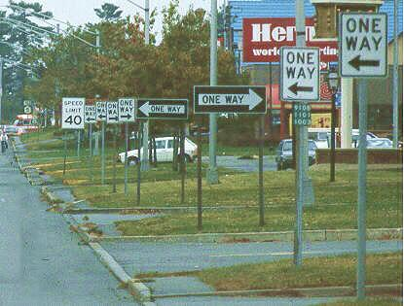
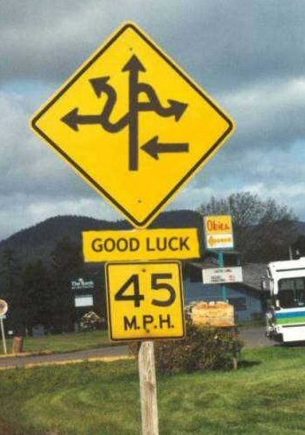
Without a clear set of values, inconsistent messages make life confusing

Slide 18
Stated Values
Operational Values
What we actually value – our highest priorities as shown by our actions and choices
What we say we value and the level of importance we say we attach to the value
There is often inconsistency between what we say that we believe and what it is we do.
ARE THEY STATED OR OPERATIONAL?
Mission or Value Statements?
Handbook rules? PBIS expectations?
School pledge? Posters?
School Improvement Goals?
Notes:
18
Stated Values and Operational Values

Slide 19
“You do not learn how to ride a bicycle by looking at pictures of bicycles in a book and studying laws of physics. You learn how to ride a bicycle by getting on a bike and riding.” - Barbara Lewis
Similarly, you learn to be a good person by the choices you make. Your actions are the result of putting what it is you value into practice.
19

Slide 20
Instrumental Values
Intrinsic Values
Beliefs about feelings and achievements that are intrinsically good and worthy as end states (not merely means to an end); they define ultimate goals.
Beliefs about what is important to achieve other goals or outcomes. These are intermediate values; means to an end.
Notes:
20
Intrinsic and instrumental values.
Beliefs about feelings and achievements that are intrinsically good and worthy as end states (not merely means to an end); they define ultimate goals.
Beliefs about what is important to achieve other goals or outcomes. These are intermediate values, means to an end.

Slide 21
Nonethical Values
Beliefs about what is effective, desirable or pleasurable without reference to the moral quality of the result; nonethical values are ethically neutral.
Ethical Values
Beliefs about what is right and good based on moral duty and virtue; beliefs about what traits of character and ways of being are morally right and good
Nonethical Values
Work EDUCATION Art & Music
Intelligence Sense of Humor WEALTH/POSSESSIONS
Independence Growth STATUS Harmony
Challenge APPROVAL Leisure Time
Ethical Values
6 Universal Ethical Values
TRUSTWORTHINESS RESPECT
RESPONSIBILITY FAIRNESS
CARING CITIZENSHIP
RELIGIOUS BELIEFS Lifestyle Choices Thrift
Premarital sex Adultery Homosexuality
Gambling Euthanasia ABORTION
FAMILY Capital punishment Drugs Drinking
Cultural and Personal
Ethical Values
Notes:
Point out difference between ethical and non-ethical values. The ones we are concerned with fall in the concepts of the Six Pillars. Again highlight the universality of these.

Slide 22
Review of Values
How is an ethical value different from a regular value?
What is the difference between a stated value and an operational value?
What is the difference between an instrumental value and an intrinsic value?
Worksheet 11 – Page 29

Slide 23
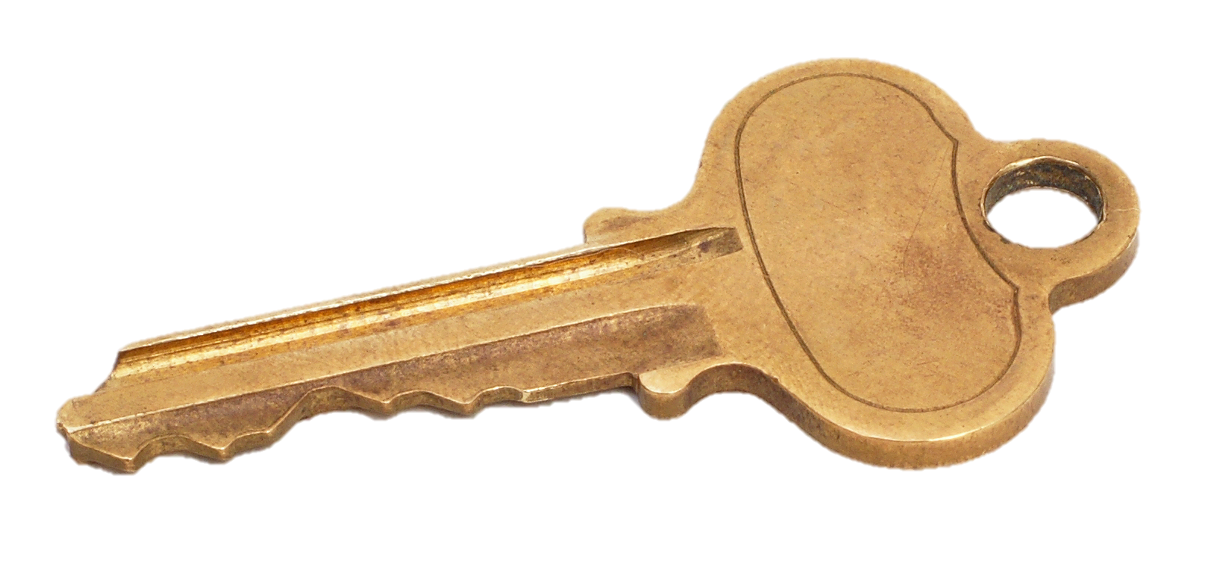
Key Values
Lock Values
Positive values (beliefs and attitudes) that unlock potential and open doors to success, personal growth and fulfillment.
Negative values that limit potential, impede achievement and prevent personal growth and fulfillment.
Notes:
23
Key values are those that help us succeed, that change our mindset from a glass half empty approach to a glass half full one.
We want to increase the number of key values our children have, to help them realize they CAN do it.

Slide 24
Video Lesson
The Dot
Notes:
The video link was active at the time of the seminar. Please understand that links can change or no longer be active.
Video found at: https://www.youtube.com/watch?v=HuxejhBOCOo

Slide 25
Are these keys or locks? Why?
Everyone lies, it’s no big deal.
No one really cares whether or not I do my homework.
I like to help out other kids when I can.
I don’t like studying but I know I will do better if I do.
If someone treats me with disrespect, they will be sorry.
I can control my temper if I want to.
There’s no limit to what I can do if I put my mind to it.
The more I plan the more I succeed.
I believe in the Golden Rule: he who has the gold, rules.
Notes:
Refer participants to the relevant pages in their workbooks.

Slide 26
What are the major lock and key beliefs of the students you work with?
Discuss and make a list of lock and key beliefs common in the students you work with. Consider locks and keys in the academic, social/emotional and character domains.
List instructional strategies to instill these beliefs
Worksheet 12 – Page 30

Slide 27
MODULE 7:
Solutions for Youth With Challenges
CHARACTER COUNTS! Offers Researched-Based
Tangible Solutions
Sensory-Processing
ADHD
Self-Regulation
Anxiety & Panic Disorders
REAL PROBLEMS FACED BY TODAY’S YOUTH

Slide 28
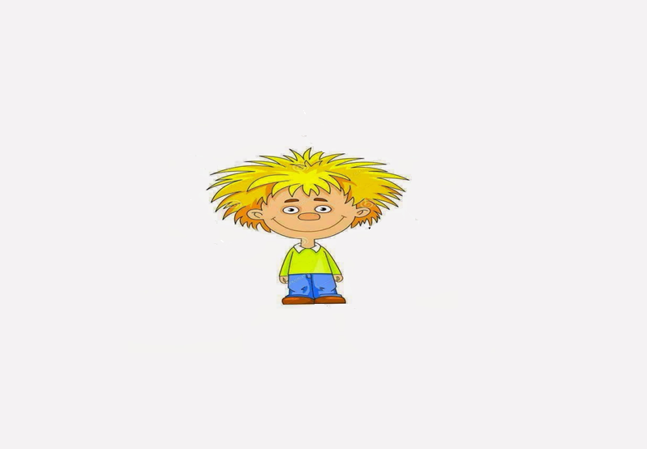
SPD – Sensory-Processing Disorder
I’m overly sensitive to loud sounds.
I have SPD!
I hate having my hair brushed, washed, or cut.
I have trouble focusing & concentrating.
I hate being tickled or cuddled.
I have poor fine-motor skills such as cutting and handwriting.
I am a picky eater. I resist new foods and textures.
I seem to be unaware of normal touch and pain. I sometimes touch others too softly or too roughly.
I have poor gross-motor skills such as running or bike-riding.
I chew on everything.

Slide 29
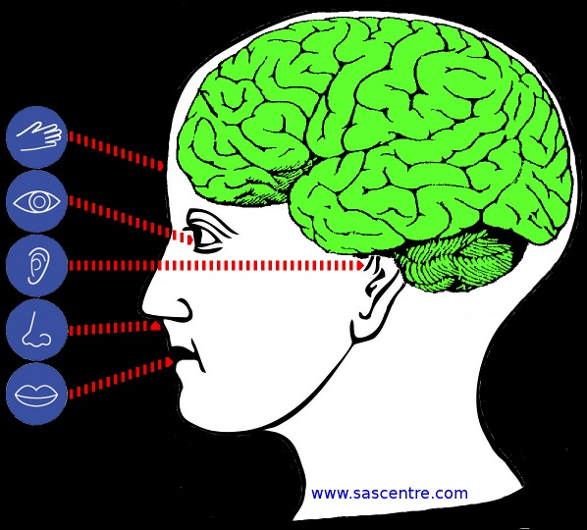
Why does SPD happen?
Those with SPD have a brain that has trouble organizing information from the senses.

Slide 30
Three Types of ADHD?
Primarily Hyperactive-Impulsive Type ADHD – These youth feel the need for constant movement – they often squirm and struggle to stay seated. They may appear to be driven by a motor and talk excessively, interrupt others, blurt out answers and struggle with self-control.
Primarily Inattentive-Type ADHD – These youth make careless mistakes because they have difficulty sustaining attention and following details, organizing tasks, are forgetful
and easily lose things.
Combined Type-ADHD – These youth demonstrate six or more of the symptoms of inattention and six or more of the symptoms of hyperactivity and impulsivity.

Slide 31
What is Self-Regulation?
PERFORMANCE
The ability to manage your emotions and behavior in accordance with the demands of the situation.
Being able to resist highly emotional reactions to upsetting stimuli.
Being able to calm yourself down when you get upset.
Self-Regulation
Being able to adjust to a change in expectations.
Being able to adjust to a change in expectations.
Being able to handle frustration without an outburst.
Being able to direct your own behavior toward a goal despite your feelings or unpredictability of the world.
Self-regulation has been described as a combination of temperament (personality-based) and learned behavior.

Slide 32
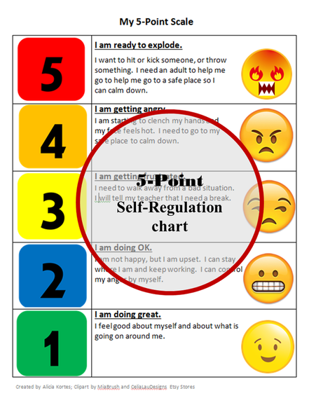

Slide 33
What are the Benefits of Fidgets?
Provides Ability to Calm
Provides ability to Focus
Provides Sensory Input
Distracts from Worries and Anxiety
Increases Ability to Pay Attention
Supports Self-Regulation
Provides Ability to Listen
Eases Social Anxiety
Supports Fine Motor Growth

Slide 34
All Examples of Fidgets or Sensory Objects
Velcro Under Seats
A variety of Pipe Cleaners
Bracelets to twirl on wrists
Rubber Bands to flip or wear on wrists
Resistance Bands
Silly Putty or other putty substance
Chip Bag Clips and others that do not make sounds
Erasers, Bendable Pencil Covers, etc.
Paper Clips or other Twisty Objects
Squeezy or Stress Balls

Slide 35
Fidget Rules and Expectations
You can’t expect youth to know how to use fidgets correctly!
Point 1
Expectations must be made clear by the teacher!
Point 2
Students must know the fidget is a tool to help with focus and is not a toy.
Point 3
Introduce the fidget primarily as an aid for focus and attention. However, they can also be used to slow their minds and bodies or to calm down and be a better listener.
Point 4

Slide 36
Fidget Rules and Expectations
Inform students they can’t have a fidget if it distracts others or interferes with the work others are doing.
Point 5
If it does interfere, use a different fidget or strategy, or take it away temporarily.
Point 6
Some students may not work well with fidgets. If this is the case, they may not be a candidate for using a fidget.
Point 7

Slide 37
Fidget Rules and Expectations
It is best for the fidget to remain in one hand and under the desk if at all possible – out of sight of the other students. Also, it is best if they do not look at the fidget. (If the fidget is a bracelet, etc., it may not apply to keep under the desk.)
Point 8
These rules are not inclusive. Do what works for you and your particular classroom or group climate.
Point 9
You may want to have practice days when you first introduce fidgets and familiarize your students slowly – a few hours at a time and work up slowly.
Point 10

Slide 38
When and Where to use a Fidget
In the Classroom During Reading Time
In the Classroom During Discussions
In the Classroom During Testing and Anxiety is Present
On the School Bus or on Car Rides
Transitions
Travel
While Watching TV
Social Times When Anxiety is Present
In the Lunchroom

Slide 39
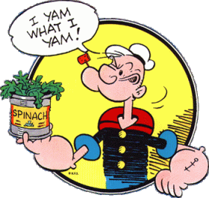
What is the aim of CBT
To increase self-awareness
To encourage a better self-understanding
To help us recognize the ‘negative traps’ or ‘vicious cycles’ we get caught in
To improve self-control by developing more appropriate cognitive and behavioral skills

Slide 40
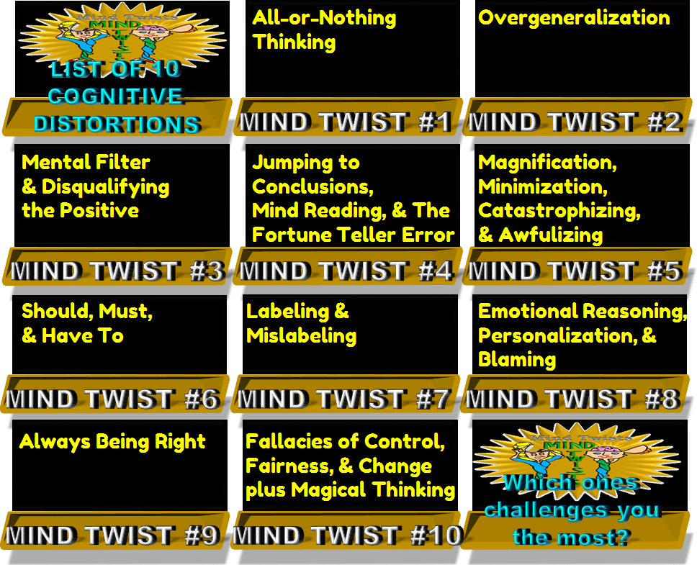

Slide 41
How do You Overcome Cognitive Distortions?
1. Recognize the irrational belief or thought.
2. Dispute the irrational belief or thought.
3. Replace it with a rational belief or thought—push it out and replace it with logic and rationality!

Slide 42
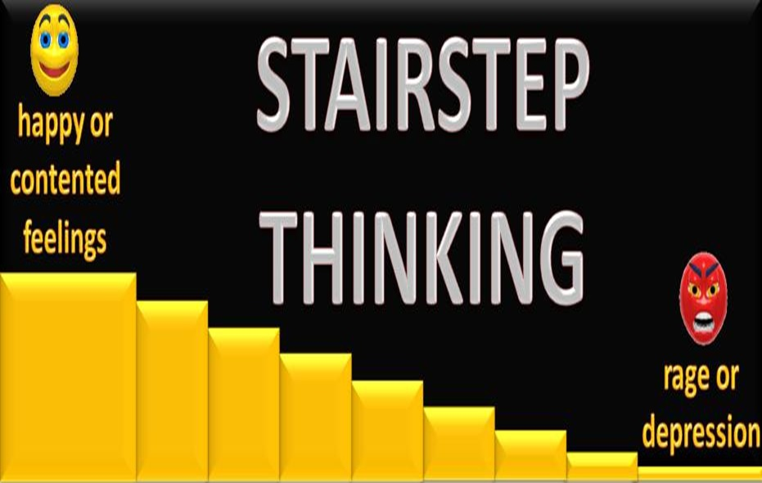
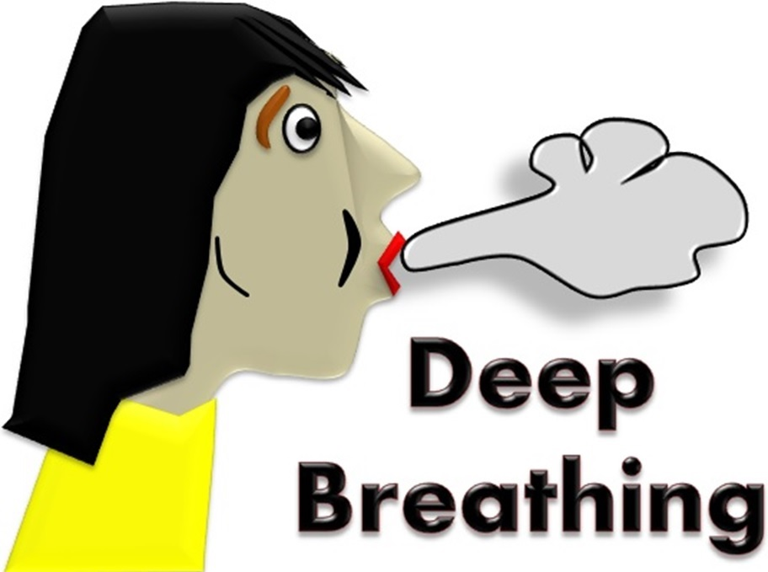
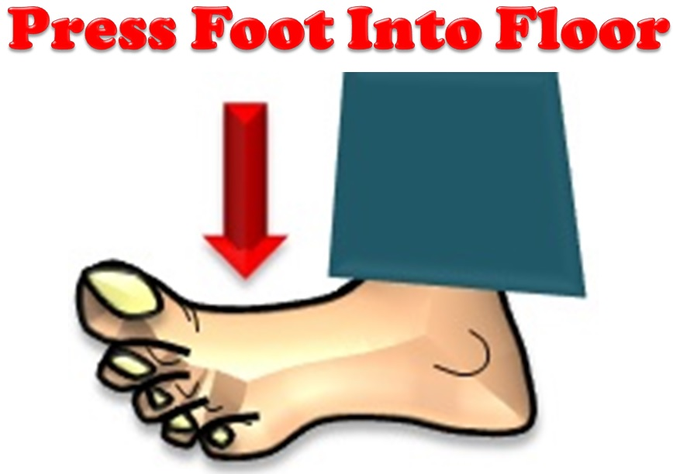
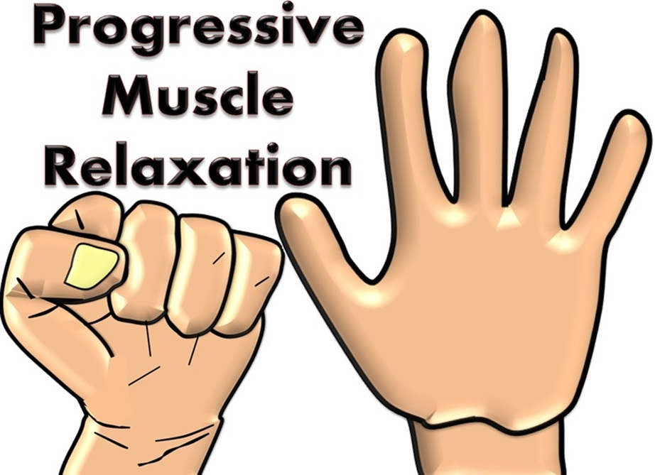

Slide 43
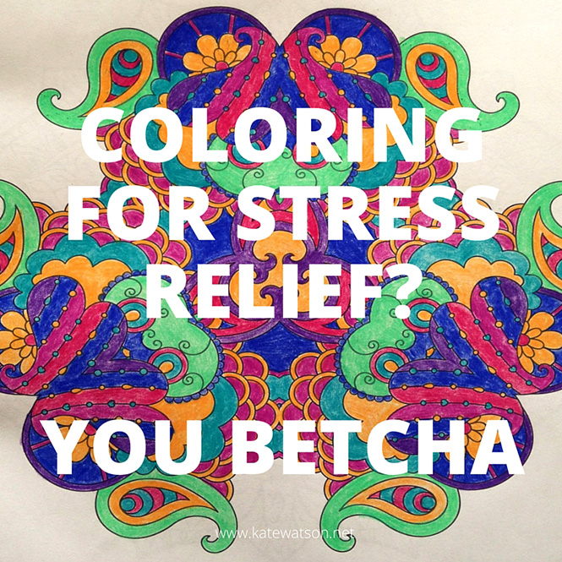
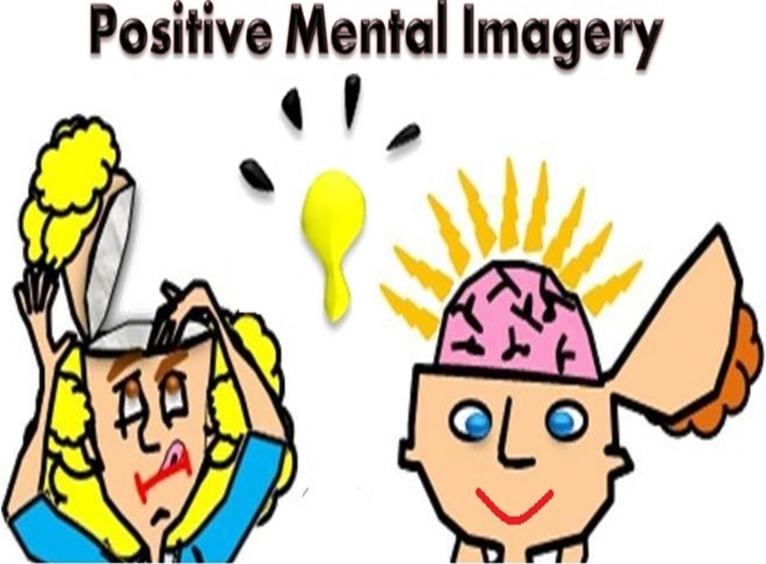
Journaling

Slide 44
MODULE 8
Strategies to instill the
Six Pillars of Character
T
TRUSTWORTHINESS
R
RESPECT
R
FAIRNESS
F
RESPONSIBILITY
C
C
CARING
CITIZENSHIP
Notes:
TEACHING THE SIX Pillars:
Have participants turn to the “Pillar Integration Handout” in their workbooks. Under each pillar is a box for key beliefs participants will fill out. There is also a section for the participants to identify specific strategies to TEAM the Pillar. These handouts should be used throughout the discussion for each of The Six Pillars. Allow participants time at the end of each module to fill out the handout for the pillar covered.

Slide 45
Aspen Declaration
The next generation will be the stewards of our communities, nation, and planet in extraordinarily critical times.
The present and future well-being of our society requires an involved, caring citizenry with good moral character.
People do not automatically develop good moral character; therefore, conscientious efforts must be made to instruct young people in the values and abilities necessary for moral decision making and conduct.
Effective character education is based on core ethical values rooted in democratic society, in particular, trustworthiness, respect, responsibility, fairness, caring, and citizenship.
One
Two
Three
Four

Slide 46
Aspen Declaration
These core ethical values transcend cultural, religious, and socioeconomic differences.
Character education is, first and foremost, an obligation of families and faith communities, but schools and youth-service organizations also have a responsibility to develop the character of young people.
Seven
The character and conduct of our youth reflect the character and conduct of society; therefore, every adult has the responsibility to teach and model the core ethical values, and every social institution has the responsibility to promote the development of good character.
Five
Six
These responsibilities are best achieved when these groups work in concert.
Eight

Slide 47
What is Character?
Notes:
47

Slide 48
Character is …
1.
Character is ethics in action.
2.
Character is the moral strength to do the right thing even if it costs more than you want to pay.
3.
Character is how you behave when no one is looking.
4.
Character is the sum total of a person’s traits and qualities.

Slide 49
Write a slogan that speaks clearly as to what is character.
Activity - Page 32

Slide 50
CHARACTER
C1. COMMITMENT TO CHARACTER AND ETHICS. Students understand the personal and social importance and the basic terminology and concepts of character and ethics. They strive to acquire the knowledge, adopt the values, and develop the skills, traits, and conduct patterns of a person of good character and they seek to govern their choices and actions by universal moral/ethical principles.
C1.1. Good Character – Components
C1.2. Importance of Character
C1.3. Responsibility for Character
C1.4. Six Pillars of Character
C1.5. Ethical Concepts and Terms
Notes:
Refer participants to the Matrix

Slide 51
Video Lesson
Twenty Things You should Say More Often
Notes:
The video link was active at the time of the seminar. Please understand that links can change or no longer be active.
Video found at: https://www.youtube.com/watch?v=HuxejhBOCOo

Slide 52
Six Pillar Poster Activity
Words
Symbols
Materials: Pillar Posters /1 piece of wall chart paper
Step 1: Divide chart paper in half. On one side list the words or phrases that represent your Pillar; on the other side list or draw symbols that represent your Pillar.
Step 3: Using one of the key beliefs, prepare a learning experience.
A. THE WHAT - WHAT do you want your students to know (or do). Identify the content or skill to be learned.
B. THE HOW - HOW will students learn? What methods, strategies, tools or activities will you use to make sure they get it?
C. THE WHY - WHY are students learning this skill? Why do students need to know or do this? What’s in it for them? How do they benefit?
Step 2: Using the words and symbols, write key beliefs for students.

Slide 53
Create a Six Pillar Commercial
Using what you learned from the Six Pillar Poster Activity, pick out the most significant aspects of your Pillar.
As a Pillar Team, please create a “commercial” no longer than 2 minutes to “sell” the value.
You may use material(s) in the room.
All members of the group must participate.
You may practice in any space where your team can work effectively together.

Slide 54
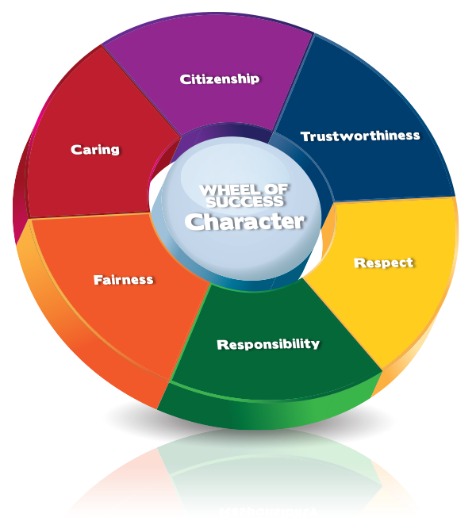
C2. TRUSTWORTHINESS
Students recognize both the moral and practical significance of trustworthiness as an essential ingredient in meaningful relationships and career success. They strive to earn and maintain the trust of others by consistently demonstrating the integrity, honesty, promise-keeping and loyalty.

Slide 55
Aspects of Trustworthiness
C2.1. Integrity
C2.2. Honest Communications
C2.3. Honest Actions
C2.4. Belief That Honesty Pays
C2.5. Promise-Keeping & Reliability
C2.6. Loyalty

Slide 56
TRUSTWORTHINESS
I will be a better student if I act on the following beliefs:
Trust is essential to all of my important relationships.
Honesty is the best policy.
I should keep my promises.
It’s not worth it to lie or cheat because it hurts my character.

Slide 57
TRUSTWORTHINESS
 | Elementary | Secondary
Key Questions | What is trust? How can I be honest when talking with others? | Why is it important to have trustworthy relationships? What is integrity? What are the key elements of trustworthiness?
Supporting Questions | Who is important to me? What is right and wrong? Whom do I trust? Should I trust everybody? When I make a mistake, what should I do? | What does it mean to trust others? How can I be dependable? Why is it important to be consistent? When trust is broken or absent, what are the results? Can trust be repaired?
Key Concepts | Honesty, integrity, promise-keeping, loyalty
Notes:
As you go through the final slide, point out that these essential questions are in their workbooks and are from the Connect With Character user’s guide.
The questions act as instructional guides. When students have understood the concepts of trustworthiness the questions will help them construct the knowledge learned and apply it to their everyday lives.
There is slide for each of the Pillars.

Slide 58
Video Lesson
The Legend of Bagger Vance
Notes:
The video link was active at the time of the seminar. Please understand that links can change or no longer be active.
Video found at: https://www.youtube.com/watch?v=HuxejhBOCOo

Slide 59
Video Lesson
Liar, Liar
Notes:
The video link was active at the time of the seminar. Please understand that links can change or no longer be active.
Video found at: https://www.youtube.com/watch?v=HuxejhBOCOo

Slide 60
White lies often look very different from the perspective of the person lied to.
Thank you for caring.
So, what else have you lied to me about?!
THE TEST:
Upon learning of the lie, would the person you lied to thank you for caring? Or feel manipulated or betrayed?

Slide 61
Using the integration chart on page 34 of your Training Workbook and the Matrix, reflect on how you can intentionally Teach, Enforce, Advocate, and Model TRUSTWORTHINESS.
The process to integrate CHARACTER COUNTS! is T.E.A.M. (Teach, Enforce, Advocate, Model)
Creating an ethical climate through integration

Slide 62
C3. RESPECT
Students treat every individual with respect and judge others on their character and ability without regard to physical or personal characteristics based on the belief that all individuals are worthy and that their well-being and dignity is important simply because they are fellow human beings.

Slide 63
RESPECT
C3.1. Treating Others With Respect
C3.2. Golden Rule
C3.3. Basics Dos and Don’ts of Respect
C3.4. Respectful and Kind School Climate
C3.5. Respecting Privacy
C3.6. Respecting Others’ Autonomy

Slide 64
RESPECT
I will be a better student if I act on the following beliefs:
I should be courteous and have good manners.
I should live by the Golden Rule: Treat others the way I want to be treated.
Avoid being a bully or fighting with others.
Treat everyone the same whether they are my friend or someone I don’t know very well.

Slide 65
RESPECT
 | Elementary | Secondary
Key Questions | What is respect and self-respect? How can I respect myself and others? | How can I live by the Golden Rule? How can I gain respect? What do tolerance and the autonomy of others mean?
Supporting Questions | How do I treat others? How can I know if what I do makes others happy? What can I do to treat others the way I’d like to be treated? How do others feel? | What are the actions of respectful people? How can I show respect and be respectful? What does it mean to be tolerant of those who are different? What choices do I have to develop and maintain self-respect?
Key Concepts | The Golden Rule, civility, courtesy, accepting differences, anti-bullying

Slide 66
Universality of the Golden Rule
Confucius:
Aristotle:
Judaism:
Hinduism:
Islam:
Buddhism:
Christianity:
What you do not want done to yourself, do not do unto others.
We should behave to others as we wish others to behave to us.
What you dislike for yourself, do not do to anyone.
Do nothing to thy neighbor which thou wouldst not have him do to thee thereafter.
No one of you is a believer unless he loves for his brother what he loves for himself.
Hurt not others with that which pains thyself.
Do unto others as you would have them do unto you.

Slide 67
Video Lesson
Burger King Bullying psa
Notes:
The video link was active at the time of the seminar. Please understand that links can change or no longer be active.
Video found at: https://www.youtube.com/watch?v=HuxejhBOCOo

Slide 68
The process to integrate CHARACTER COUNTS is T.E.A.M. (Teach, Enforce, Advocate, Model)
Creating an ethical climate through integration
Using the integration chart on page 36 of your Training Workbook and the Matrix, reflect on how you can intentionally Teach, Enforce, Advocate, and Model RESPECT.

Slide 69
C3. RESPONSIBILITY
Students display responsibility by: doing what they are required to do and accepting responsibility for the consequences for what they say, do and think; and using critical thinking (A4) and decision-making (A5) skills to avoid rationalizations and excuses and make rational, prudent choices.

Slide 70
RESPONSIBILITY
C4.1. Compliance: Doing What Is Required
C4.2. Ethics: Doing What Should Be Done
C4.3. Consequences for Their Words
C4.4. Consequences for Their Actions
C4.5. Developing and Using Positive Attitudes and Life Skills
C4.6. Self-Reliance and Prudent Money Management
C4.7. Learning From Experience
C4.8. Being Rational and Reflective
C4.9. Healthy Choices

Slide 71
RESPONSIBILITY
I will be a better student if I act on the following beliefs:
I need to hold myself and others accountable for the consequences of words, actions and inactions.
I should exercise self-control and set a good example.
It is important to plan, set goals, and persist in order to be successful.
I should do what I have to do without whining or giving excuses.
I should do my best work and be my best self.

Slide 72
RESPONSIBILITY
 | Elementary | Secondary
Key Questions | What are my responsibilities? How do our responsibilities to others help us live well together? | How can we share responsibilities and be effective? What are my long-term and short-term goals? What can I do to understand my abilities and limitations?
Supporting Questions | What tasks am I expected to do? Why do I have to do things? What would happen if I didn’t do some things? How can I manage my responsibilities? | How can I develop my self-control? What can I learn from others? How can I prioritize my responsibilities? How can I develop good self-assessment skills? What can I learn from others? Do I have a sense of self-control over my behavior?
Key Concepts | Duty, accountability, pursuing excellence, exercising self-control, planning, goal-setting

Slide 73
Video Lesson
Lateefah Simon
Notes:
The video link was active at the time of the seminar. Please understand that links can change or no longer be active.
Video found at: https://www.youtube.com/watch?v=HuxejhBOCOo

Slide 74
Responsibility and Character Development
You can’t choose to be good-looking, athletic or a genius. You can’t choose your parents or the circumstances in which you grow up.
But you can choose how to deal with the outrages and opportunities of life.
From these choices, your character is formed.
Notes:
Life is full of choices. Responsibility requires we accept:
the moral obligation to choose attitudes, words, and actions
the duty to accept personal responsibility for the consequences of those actions.

Slide 75
The process to integrate CHARACTER COUNTS is T.E.A.M. (Teach, Enforce, Advocate, Model)
Creating an ethical climate through integration
Using the integration chart on page 39 of your Training Workbook and the Matrix, reflect on how you can intentionally Teach, Enforce, Advocate, and Model RESPONSIBILITY.

Slide 76
C5. FAIRNESS
Students strive to be fair in all their actions by 1) taking turns; 2) playing by the rules; 3) giving due credit to others; 4) asking for and taking only their fair share. They never 1) cheat; 2) claim credit for the work of others; 3) falsely blame or accuse others; or 4) take advantage of another’s mistakes or ignorance (even when they think they can get away with it or that the other person deserves it).

Slide 77
FAIRNESS
C5. Fairness. Students strive to be fair and just in all their actions
C5.1. Basics Dos and Don’ts of Fairness
C5.2. Making Fair Decisions
C5.3. Proportionality
C5.4. Complexity of Fairness

Slide 78
FAIRNESS
I will be a better student if I act on the following beliefs:
Treat all people equitably based on their merits and abilities.
Accept the fact that something is not unfair just because I didn’t get what I wanted.
Willingly take turns and share with others.
Understand the importance of rules to define games, establish order and common expectations.

Slide 79
FAIRNESS
 | Elementary | Secondary
Key Questions | What is fair and unfair? How can I learn to make fair decisions? | What do fairness and justice represent? How can I avoid being unfair? What moral obligations are involved in fairness and unfairness?
Supporting Questions | Why is it important to play fairly and to share? What can I do to play fairly? What does fairness mean to me? How can I put into practice fair decision-making? | What do fairness and justice mean to me? How can I accept fairness when it means I don’t get what I want? What course of action should I take when I see something unfair? What and who will be affected by my being unfair? What is a moral obligation?
Key Concepts | Justice, equity, equality, openness, impartiality, consistency

Slide 80
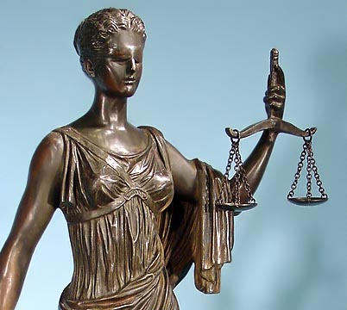
Process – How we make decisions.
The moral obligation is to make decisions fairly. This is called procedural fairness.
Results – What we decide (the substance of the decision). The consequences or benefits should be fair.
The moral obligation is to make fair decisions. This is called substantive fairness.
Notes:
(Fairness). Be consistent, open, and treat all people equitably. Consider all sides and make decisions on the facts without favoritism or prejudice. Play by the rules, avoid careless accusations, don’t take undue advantage of others. Pursue justice and condemn injustice.

Slide 81
Procedural Fairness Requires...
Gathering of the facts
Fair hearing
Fairness
Fair Notice
Impartiality
Procedural

Slide 82
Six Major Theories of Fairness
1 Equality: treating everyone the same with everyone starting from the same place and needing the same help.
3 Effort: given in proportion to the effort extended.
4 Seniority:
benefits distributed in order of age or seniority.
5 Need: equity means giving everyone what they need to be successful
2 Merit: what a person is entitled to receive based on skill or talent.
6 Might: determined on the basis of power granted.

Slide 83
Video Lesson
Glory
Notes:
The video link was active at the time of the seminar. Please understand that links can change or no longer be active.
Video found at: https://www.youtube.com/watch?v=HuxejhBOCOo

Slide 84
The process to integrate CHARACTER COUNTS is T.E.A.M. (Teach, Enforce, Advocate, Model)
Creating an ethical climate through integration
Using the integration chart on page 42 of your Training Workbook and the Matrix, reflect on how you can intentionally Teach, Enforce, Advocate, and Model FAIRNESS.

Slide 85
C6. CARING
Students demonstrate caring by: 1) displaying sincere concern for the well-being of others; 2) displaying compassion for those in pain or need; 3) being kind and sympathetic to everyone (even those who don’t seem worthy of kindness); 4) giving time, service and money to charitable organizations and individuals to help those in need.

Slide 86
CARING
C6.1.Basic Dos and Don’ts of Caring
C6.2. Caring Moderates Other Ethical Duties
Students understand the virtue of caring frequently interacts with other ethical principles requiring them to be careful that:
Honesty is not causing them to be unnecessarily hurtful or offensively blunt.
In seeking to impose justice, they do not miss opportunities to be merciful and forgiving.
While respecting another’s privacy, they do not condone or ignore dangerous and harmful conduct.
Their sense of responsibility is proportionate to their level of authority and and that they do not ignore their own needs.

Slide 87
CARING
I will be a better student if I act on the following beliefs:
I have to show concern for others’ well-being.
I should act compassionately and with empathy.
I need to be kind and considerate.
I have to be willing to show mercy and forgiveness.

Slide 88
CARING
 | Elementary | Secondary
Key Questions | How can I show I care? How can I develop empathy? | How can I become more altruistic? How can I learn forgiveness? How can I show conviction for and commitment to being a caring person?
Supporting Questions | What does caring mean? How can I care for my friends? Who cares for me? How can I show caring? What happens when I hurt someone? How do I feel when I am hurt by someone? | How do I feel when someone helps me? What should I think about when others need help? What should I do when someone hurts me? How can I avoid hurting others? What can I learn from people who’ve forgiven me for mistakes I’ve made? How can I teach others to be more caring?
Key Concepts | Concern for others, kindness, compassion, love, charity, empathy, mercy, forgiveness

Slide 89
Video Lesson
Change Your Words
Notes:
The video link was active at the time of the seminar. Please understand that links can change or no longer be active.
Video found at: https://www.youtube.com/watch?v=HuxejhBOCOo

Slide 90
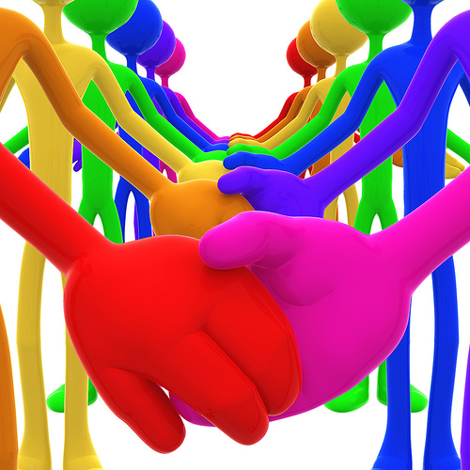
Creating a Culture of Kindness
A Culture of Kindness exists when the climate of a place promotes kindness and discourages unkind thoughts and actions.
Empathy, compassion, caring and respect are expected and their opposites are out of place.
Notes:
Follow slide content.

Slide 91
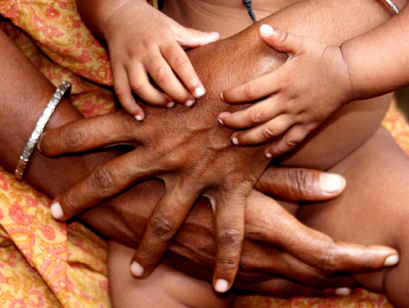
Creating a Culture of Kindness
In a Culture of Kindness, all social incentives encourage and affirm a spirit of generosity and love and discourage all forms of hurtful or demeaning words or acts.
In a Culture of Kindness, everyone feels at home.
Notes:
Each member of the community is aware of and understand empathetic behavior. They do not stand for mean or cruel behaviors and act quickly to remedy the situation. Bystanders know their role, and strategies are provided for the targets of bullying behaviors.
Bullying behaviors are different from good natured teasing. The difference is when the teasing becomes hurtful or distressful, it stops.

Slide 92
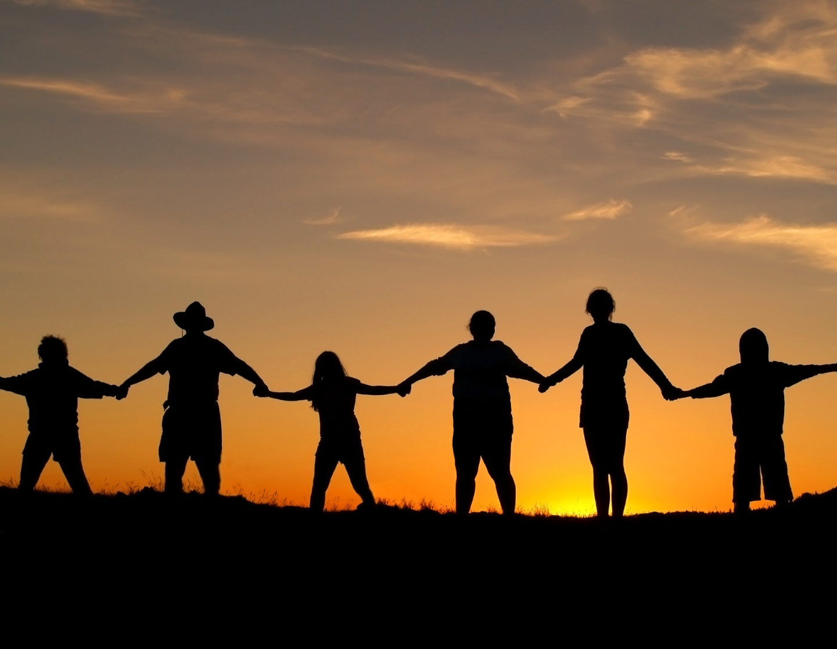
Creating a Culture of Kindness
In a Culture of Kindness, differences are accepted and celebrated.
In a Culture of Kindness, it’s all for one and one for all; people stand up for and next to each other.
Notes:
In the workshop there are components that deal with respecting differences and role plays.
The matrices in the workbook participants have demonstrate the behaviors that are acceptable and the course of action that should be taken if bullying behaviors are evident.

Slide 93
The process to integrate CHARACTER COUNTS is T.E.A.M. (Teach, Enforce, Advocate, Model)
Creating an ethical climate through integration
Using the integration chart on page 48 of your Training Workbook and the Matrix, reflect on how you can intentionally Teach, Enforce, Advocate, and Model CARING.

Slide 94
C7. CITIZENSHIP
Students recognize and seek to fulfill their civic and social responsibilities by doing their share to contribute to the well-being of the communities in which they are a member (including their school, neighborhood and country).

Slide 95
CITIZENSHIP
C7.1. Understand and Appreciate Civil Rights
C7.2. Understand and Fulfill Civil Responsibilities
C7.3 Respect Authority and Obey Laws
C7.4. Participate in Democratic Process
C7.5. Positive Learning Opportunity
C7.6. Safeguard the Environment

Slide 96
CITIZENSHIP
I will be a better student if I act on the following beliefs:
I will play by the rules.
I need to obey the law.
I should do my share in my family, class, school and community.
I recognize my duty to protect and improve the environments in which I live.

Slide 97
CITIZENSHIP
 | Elementary | Secondary
Key Questions | What does it mean to be a good citizen? What are rules? | What are my civic duties? How do I enact and protect democratic values?
Supporting Questions | Why do we have rules? How can I help? Why should I do my share? What does it mean to be a good neighbor? | What communities do I belong to? How can I make a difference? What is the common good? What are the values of my communities? How can I participate actively for the collective benefit of communities? When is civil disobedience appropriate? How can I be an advocate for a cause?
Key Concepts | Playing by the rules, Being a good citizen, Sharing

Slide 98
Video Lesson
Tum Chalo
Notes:
The video link was active at the time of the seminar. Please understand that links can change or no longer be active.
Video found at: https://www.youtube.com/watch?v=HuxejhBOCOo

Slide 99
You are to create an Ad Campaign promoting a Culture of Kindness to show that students care about each other.
Slogan for the campaign
Write at least 3 action items that would help to promote the Culture of Kindness campaign
Worksheet 15 – Page 50

Slide 100
The process to integrate CHARACTER COUNTS is T.E.A.M. (Teach, Enforce, Advocate, Model)
Creating an ethical climate through integration
Using the integration chart on page 51 of your Training Workbook and the Matrix, reflect on how you can intentionally Teach, Enforce, Advocate, and Model CITIZENSHIP.
With a partner: Share three specific ways to Teach, Enforce, Advocate, and Model the Pillars

Slide 101
MODULE 9
Social and Emotional Domain and Success Skills

Slide 102
Success Skills in the Social and Emotional Domain
Self-Discipline
Resilience
Diligence
Perseverance
Positivity

Slide 103
Success Skill of Self-Discipline
Students demonstrate self-discipline by:
Doing what they should do even when they might be able to get away with misbehavior.
Doing what they need to do without excuses.
KEY BELIEFS
I can make sure that my behavior is appropriate and reflects my values.
Just because I feel like doing something doesn’t mean I should, or that I have to do it.
INSTRUCTIONAL STRATEGIES
Explain and illustrate how to make positive decisions in difficult situations, resist peer pressure and exercise self-control.
Role-play scenarios in which students may be tempted to engage in destructive behaviors.
Explain and illustrate what self-discipline looks like with stories, exercises and activities.

Slide 104
Success Skill of Resilience
Students demonstrate resilience by:
Maintaining a positive outlook with the courage and will to bounce back from the pain and grief of personal traumas disappointments, failures and misfortunes.
KEY BELIEFS
Negativity in life or in others does not change who I know I am.
Even when life is tough, I know I can survive.
INSTRUCTIONAL STRATEGIES
Practice strategies for handling difficult people and challenges.
From current events and literature, analyze how people face and bounce back from tragedy.
Teach and demonstrate how to overcome obstacles so students can take control of their lives and their education.

Slide 105
“More than education, more than experience, more than training a person’s level of resilience will determine who succeeds and fails. That’s true in the cancer ward, in the Olympics and in the corporate boardroom.”- Dean M. Becker

Slide 106
What Can One Do?
Encourage students, parents and educators to identify the after effects of specific experiences.
Introduce specific strategies that promote resilience.

Slide 107
Strategies to Increase Resilience
1) Strengthen ability to regulate emotions such as sadness, grief, anger fear, jealousy, hatred, resentment
2) Reject negative mindsets and adopt a positive (but realistic) outlook
3) Physical activity or mindfulness experiences
4) Take on new challenges while focusing on lessons learned that make you smarter or stronger
5) Create or fall back on a supportive social network
6) Observe and emulate resilient role models -if they can do it, so can I
7) Diversion and distraction or reframe the experience
Notes:
Diversion and distraction
Reframe experience

Slide 108
Success Skill of Diligence
Students demonstrate discipline by:
Pursuing excellence in all they do. They understand the importance of effort and hard work, and they always strive to do their best.
KEY BELIEFS
It’s worth it to do my best work in all I do.
I might not be the best, but I will try to be the best me.
INSTRUCTIONAL STRATEGIES
Set expectations of excellence from all students.
Acknowledge best efforts, not just best results.

Slide 109
DILIGENCE
Instilling in students the skill of being diligent, persistent and hardworking, can be a herculean task for teachers.
Who wouldn’t want to work hard, complete what it is they have to do and not just give up when things get tough?
Developing the skill of diligence just does not happen by chance. Think of your own success as a student or now as an educator and how diligence played a major role.
As with any of the desired character traits, we realize the change is not in the why or what; rather it is in the how.
VIDEO AND DISCUSSION LESSON: Diligence Changes Just OK Into Can Do http://bit.ly/2YH3HhJ

Slide 110
Success Skill of Perseverance
Students demonstrate perseverance by:
Continuing to perform their responsibilities and pursue their goals despite frustrations, mistakes, setbacks, and other obstacles that make their task difficult or seem impossible.
KEY BELIEFS
I am able to resist temptations and pressures to give up or quit.
I choose to persist as long as I am able.
INSTRUCTIONAL STRATEGIES
Research individuals from a historical perspective to document examples of perseverance.
Have students discuss mistakes they have made and how they could have turned them into learning opportunities.

Slide 111
Success Skill of Positivity
Students demonstrate positivity by:
Choosing to be optimistic, enthusiastic, hopeful, and cheerful.
KEY BELIEFS
Having a positive outlook can help accomplish positive results.
I understand how having a negative attitude can affect my happiness and I will choose to find a positive alternative..
INSTRUCTIONAL STRATEGIES
Provide opportunities for students to understand that they can’t always control the situation, but can control how they choose to respond.
Have students share negative dialogue they might have and turn it into a positive dialogue.

Slide 112
Mindsets Can Be Changed
Our mindsets regarding certain aspects of our lives is based on our choice of meaning we give to things.
We all can consciously decide to develop a positive mindset.
Half-full perspective, looking for the bright side of every event
Believing in the personal ability to endure adverse events
Believing things can and will get better

Slide 113
Power of Positive Thinking
Negative thoughts - doubt, fear, worry, doom and gloom, focusing on what could go wrong - diminish the quality of life
The power of positive thinking is the ability to reduce or eliminate the impact of negative thoughts
Benefit of taking time to think of 5 things you are grateful for.

Slide 114
Video Lesson
The Greatest
Notes:
An alternative to the video clips from Pay It Forward. A story from “In Search of Character.” This clip speaks directly about change in a young person’s behavior because he believed it was worth it and then he sets forth a direction to change his life.

Slide 115
Social and Emotional Domain
Self- Discipline Perseverance
Resilience Diligence
Positivity
Choose 2 of the above traits from the Social and Emotional Domain:
Identify at least three reasons why teaching the skill is important.
What are the key beliefs you would like to instill in students?
Each person chooses one of the Way To Go lessons. Teach the lesson.
Review the Social and Emotional skills. Identify any other skills that would be critical for inclusion in your school.
Worksheet 16 – Page 53

Slide 116
MODULE 10
Taking Choices Seriously: Exemplary Decision Making

Slide 117
The quality of our lives and the success of our efforts in both our personal and professional lives will be determined by our choices.

Slide 118
Every Decision Sends a Message
In addition to the immediate and long term effects of a decision on our own lives, every decision we make sends a message to the world as to what we value and what kind of people we are.
Thus, we should always consider the potential impact of our choices on our reputation and credibility.

Slide 119
Two Core Principles for Good Decision Making
We have the power to decide what we think, say and do.
We’re morally responsible for the consequences of our choices.

Slide 120
Actions are the result of choices
Attitudes are the result of choices
Choices create consequences
Each change in attitude or actions creates different consequences
Good choices create good consequences

Slide 121
Good choices produce good results.
Better choices create better results.
The best choices produce the BEST POSSIBLE RESULT.

Slide 122
What We Need to Teach Children and Young People
Decision-Making
To think of all choices in terms of potential consequences to themselves and to others (stakeholders)
Every decision has consequences
The greater the potential consequences, the higher the stakes
The higher the stakes, the more need there is for careful decision-making

Slide 123
Stakeholders
Each person who can be affected by a decision has a “stake” in that decision and a moral claim on the decision maker to make the decision wisely and ethically.
Notes:
Follow slides.

Slide 124
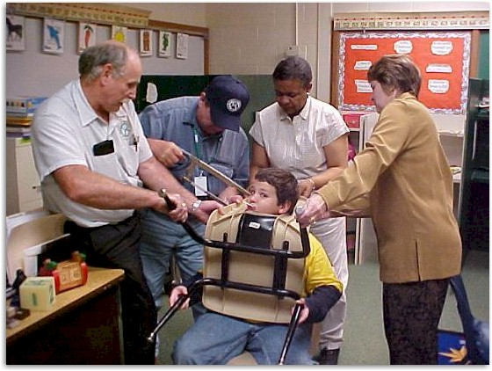
CHOICES HAVE CONSEQUENCES Everyone affected by a decision is a stakeholder in that decision.
Look how many people were affected by this young man’s decision to stick his head through the opening in the back of his chair.
Notes:
Ethics in Public Administration
(c)2006 Josephson Institute
124

Slide 125
Aspects of an Exemplary Decision
Based on sufficient reliable information
Effectively accomplishes the decision-maker’s objectives
Efficient
Avoids unintended consequences
Results in the most good and the least harm to each stakeholder.
Is and appears to be ethical
Generates trust
Treats all stakeholders respectfully
Is fair to all concerned
Demonstrates caring and concern for all stakeholders
Abides by laws and rules
Acknowledges and fulfills the decision-maker’s responsibilities

Slide 126
Publicity Test
Role-Model Test
Golden Rule test: Would I want people to do this to me?
The what‐if‐everybody‐did‐this test: Would I like it if everyone else did this?
Tests for Making Good Decisions
Notes:
Go over all tests for making ethical decisions.

Slide 127
Rule of Universality
Do only those acts which you are willing to allow to become universal standards of behavior applicable to all people in similar situations.
If everyone did it, would it be a good thing?

Slide 128
Best Possible Result (BPR)
Effectively accomplishes the primary objective, in that it solves the immediate problem
Avoids negative unintended consequences
Solves the underlying problem, while providing a broader solution and avoiding future problems
Preserves or advances the decision maker’s relationships
Enhances the decision maker’s credibility

Slide 129
Recognizing Important Decisions
Is there possible danger of physical harm to you or anyone else?
Could you or someone else suffer serious emotional pain?
Could the decision hurt your reputation?
Could the decision impede achieving an important goal?
Could you or someone else suffer significant monetary or property loss?

Slide 130
DECISION-MAKING
Key Questions | Who are the stakeholders? How can I make a good decision? What strategies can I use to make a good choice?
Supporting Questions | Why should I make good or right decisions? Who/what do I need to think about to make good decisions? Who will be affected by my decision? How can I find out if I’m making a good ethical decision? How can I make better decisions? How can I change the way I make decisions to improve the outcome? What steps should I take to achieve a good result for most stakeholders? How can I help others to make better ethical decisions?
Key Concepts | Stakeholders, thinking, clarifying goals, developing options, effective and ethical decisions, best possible result, consequences

Slide 131
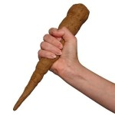
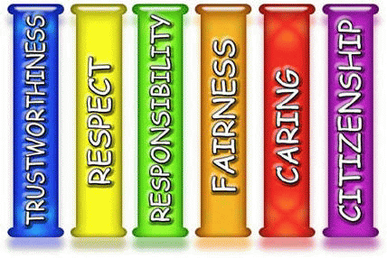
Good decisions are effective and ethical
JI Character-Based Decision-Making Model
1. Ethical decisions take into account the interests and well-being of everyone affected by your actions (stakeholders).
2. Ethical decisions put values of Trustworthiness, Respect, Responsibility, Fairness, Caring, & Citizenship above others.
3. If it is necessary to violate one core ethical value to honor another, do what will produce the greatest good in the long run.
2.
1.
3.
Best in long run

Slide 132
Count off by 4 and create a small group that will work through the following role play at your table.
Jamie is a High School Junior. As part of the science class, Jamie is one member of a cooperative learning group that has to complete a project by the following Monday. Each member of the group has a specific responsibility to complete for the project. The group has decided to work on Friday after school and on Saturday morning to put together the project so it can be completed by the Monday deadline. On Thursday, Jamie is invited by a good friend to a concert on Friday evening. Jamie quickly decides to go. Before leaving on Friday, Jamie meets with the other members of the group to share the decision to go to the concert and that there is no way possible to be in any condition to get up early on Saturday to work on the project. Sunday is out as two other members of the group have family commitments.
In Your Group
The member of your group who has the next birthday plays the role of Jamie. You need to:
Present arguments that explain the choice you have made.
Convey the process used to make the decision to go to the concert.
The other 3 are members of the cooperative learning group. Each will need to :
Respond to Jamie about the choice made.
Who are the stakeholders in his decision?
Discuss what is important in order to accomplish the assigned project.
Share what are the unintended consequences of the choice Jamie has made.
Finally, as a group, discuss what could be a decision that Jamie may make to produce the best possible result.
Notes:
Cooperative group activity.
Break up into groups of 4 with one individual being Jamie (M or F). The remaining individuals are members of the cooperative learning group.

Slide 133
Students have friends in another class with the same teacher. Sara and Julie are best friends and tell each other everything. Sara goes to class first and gets all of the answers for last night's homework. Julie doesn't like history, but didn't finish her homework and asks Sara for help.
Who are the stakeholders in this scenario?
What Pillars is Sara struggling with in deciding how to answer Julie?
What do you think Sara would do?
Give Julie the answers because they are best friends.
Sara can give Julie some of the answers and tell her to finish the homework at lunch.
Tell Julie she can’t help her.
Sara will take time to help Julie complete the homework during lunch, not by giving her the answers but assisting her where she can find them.
Tell Julie it would be cheating if she gave her the answers.
What do you think Sara ought to do? What does Sara have to think about when making her decision?

Slide 135
Brian is looking forward to the start of the new school year. Right from the first day, Brian’s good friends are making fun of a new student who has just moved into the neighborhood. They all joke about how he looks and talks. While walking home after school, one of Brian’s friends decides to pick a fight with the new student. Before you know it, others are joining in.
Who are the stakeholders?
What options does Brian have?
What are the potential consequences of his possible choices?
Who else will be impacted by the decision he makes?
What do you think Brian will decide to do?
What do you think Brian should do?

Slide 137
Kara is a high school freshman. Last weekend, she is arrested by department store security for shoplifting. She had over $30 in her purse, and was trying to steal a blouse for $18. She said that the friends she was with were all swiping things that day, but didn't get caught, and that they were all encouraging her to join in the fun of getting stuff for free.
Why did Kara choose to steal?
In her decision to steal, who are the stakeholders she should have thought of?
What values are in conflict for Kara?
When confronted with a choice of stealing to fit in or doing the right thing, what should Kara think about before making a decision?
What were Kara’s options?
What are the consequences of the various options open to Kara?
What would have been the best decision for Kara? How do you know?

Slide 139
Day 2 Homework - Dialogue Presentations
The Six Pillars and the Six Success Skills?
What is T.E.A.M.
Discuss Decision-Making (Stakeholders)
CHARACTER COUNTS! 6.0 Presentation
School Climate
Topics are on page 57
Notes:
Ethics in Public Administration
(c)2006 Josephson Institute
139

Slide 140
CHARACTER COUNTS! is a project of
CHARACTER COUNTS! and the Six Pillars of Character are trademarks of the Josephson Institute.

