Slide 1

CHARACTER COUNTS! 6.0
Student Development Workshop
Day 1

Slide 2

On the table are posters with statements and quotations. Please walk around and put a dot on up to 5 statements or quotations you strongly agree with. (Please use the stickers found at your table).
Choose one of the quotations that resonates with you and copy it on Worksheet 1 on page 4 of the Training Workbook.
Answer the following questions:
Why do I like it?
What does it mean?
What are the values embedded in the quote?
Notes:
Ethics in Public Administration
(c)2006 Josephson Institute
2
Poster Activity
Fills time on arrival
Provides informal opportunity for interaction
Engages student in thinking about values wise sayings
Eases student into scope and seriousness of training
Sets up early exercise where a portion of the class can be asked to identify their favorite quote from this exercise
Collect posters at break and refer to top vote getters in discussion of values as beliefs

Slide 3
MODULE 1
The CHARACTER COUNTS! Perspective on Student Development

Slide 4
What does your team hope to gain from the CHARACTER COUNTS! 6.0 Student Development Workshop?
What would make the greatest difference at your school with a successfully implemented CHARACTER COUNTS! initiative?
Goal 1:
Goal 2:
Goal 3:
Goal 4:
Worksheet 2 – Page 5

Slide 5
Workshop Goals
Share strategies to ensure integration with the academic curriculum and all activities of the school.
Provide support for our CC! Champions to be able to train, support and engage others at your school or organization.
Discuss how to bring about change in a school regarding staff attitudes about character and the effort needed to change student behavior.
Have teams leave the workshop with an implementation plan that is organized and purposeful.
Understand that CHARACTER COUNTS! promotes the Six Pillars of Character and the desired traits in the Social/Emotional and Academic domains and school climate.

Slide 6
Introduction Video
Game of Hope
Notes:
The video link was active at the time of the seminar. Please understand that links can change or no longer be active.
Video found at: https://www.youtube.com/watch?v=HuxejhBOCOo

Slide 7
Introduction Video
Haircut
Notes:
The video link was active at the time of the seminar. Please understand that links can change or no longer be active.
https://www.youtube.com/watch?v=T_i34m981-Y

Slide 8
Overarching Themes
MINDSETS - Collection of beliefs that make up our mental attitude, habit or disposition that influences or determines a person’s interpretations and responses to events and situations.
BELIEFS - Our basic beliefs and convictions are called values. Our values are reflected in the attributes that comprise our character, for moral good or the skills that will drive our actions.
BEHAVIORS – A reflection of our deeply held beliefs, determined by our choices, affecting both our emotional responses and our ability and willingness to sacrifice self interest and do the right thing.

Slide 9
CHARACTER COUNTS! 6.0 MODULES
1. The CC! Perspective on Student Development
2. School Improvement Through CC! 6.0
3. Principles of Change and Mindsets
6. Values, Key and Lock Beliefs
7. Solutions for Youth With Challenges
10. Taking Choices Seriously: Exemplary Decision Making
11. Implementation Strategies
12. Work of a CC! Team
4. Academic Wheel Of Success and Learning
5. Promoting a Positive School Climate
9. Social and Emotional Domain and Success Skills
8. Strategies to Instill the Six Pillars of Character

Slide 10
Circle Within a Circle
Count off by: 1) Academic, 2) Social/Emotional 3) Character 4) School Climate. Form two circles: Academic and Social/Emotional inside facing Character and Climate outside
Outer to Inner: What is the most inspirational movie you’ve seen? Why? Inner-Outer: Who was your favorite teacher? Why?
Inner circle: move clockwise two spaces.
Outer-Inner: What is the best experience you have had personally as a student? What made it so good? Inner-Outer: What was the most satisfying work experience you’ve had.

Slide 11
Outer circle: move four spaces clockwise. Outer-Inner: Who has had the most impact on your character? How did he/she do it? Inner-Outer: Describe a situation where you think you had a permanent impact on the values of a young person (other than a member of your family).
  Inner circle: move two spaces to the right; Outer: move four spaces to the left.
What feelings did the Game of Hope video about the team that cheered for their opponents evoke in you? Why?
  Inner circle change places with outer circle so inner becomes outer and vice versa.
Inner move clockwise five spaces. Outer-Inner: What are your concerns about implementing CHARACTER COUNTS! 6.0? Inner-Outer: Respond to all the stated concerns.

Slide 12
Teaching/Learning Objectives of Circle Within a Circle Activity
What was the purpose and value of the activity?
What did you notice about the progression of the questions?
What was purpose and impact of increasingly complicated movement instructions?
How could you effectively use this technique with students, colleagues, and parents?
Which of the questions had the most impact on you? Why?
Worksheet 3 – Page 6
Notes:
What was purpose and value of activity?
Ice-breaker
Get everyone talking
Begin introductions
Create movement – kinesthetic – maintain energy
Create enthusiasm
Fun
What did you notice about the progression of the questions
Personal - easy, no possibility of failure
Personal experience – inspire commitment
Opinions – induce reflection
Application – focus on use
What was purpose and impact of increasingly complicated movement instructions?
What happened when I first asked both the inner and outer circles to move. How did your circle adjust to the initial chaos?
Did you observe how a simple strategy – one group finishing its move before the other group started solved the problem and made a complex challenge simple?
This is the sort of thing we need to teach children: simple strategies learned and used can make their lives easier and make them more effective.
This is a prelude to the growth mindset concept demonstrating that we can all become smarter by learning strategies and approaches.
Do you think this activity increases the likelihood that participants will approach the training with a more positive or relaxed attitude?
Do you think it will affect the willingness of some people to more fully participate in class discussions?

Slide 13
Benefits of Circle Activity
Method of getting everyone engaged, everyone talks
Covers lots of concepts/material quickly and can be used for subject content as well
Provides physical movement for brain activity
Emphasizes communication and the importance of listening to others and following detailed instructions
Provides challenge and opportunity for a problem-solving strategy regarding complex instructions

Slide 14
Note that the chaos of two circles moving simultaneously can become easy and simple with a strategy -- only one circle moves at a time.
Our goal is to give you strategies to share with your students in each domain of their development so they can more easily and successfully progress.
This is the basis of the growth mindset – a positive attitude toward learning.

Slide 15
Trainer Introduction
Training Workbook
PPT slides converted to text
Worksheets and activities
PowerPoint slides
Addendum
Model Standards in 1) Academic 2) Social and Emotional 3) Character Domains 4) School Climate
Matrix of outcomes and instructional strategies in 1) Academic 2) Social and Emotional 3) Character
All resources for the course can be downloaded at:
http://resources.charactercounts.org/free-resources/training/

Slide 16
Glad You Are Here!
Names and school position
What does your team hope to gain from the CHARACTER COUNTS! 6.0 Student Development Workshop?
What would make the greatest difference at your school with a successfully implemented or enhanced CHARACTER COUNTS! initiative?
Share your goals:
Notes:
Activity:
Refer to the groups you created for Circle in a Circle.. Appoint a timekeeper, a student with a watch that has a second hand.
This is a TIMED exercise to assure that all your time is used effectively and that everyone has the same fair opportunity to express themselves. We are serious about the time and will appoint a time-keeper. We will ask you to stop when your time is up even if you are in mid-sentence.
The information will help clarify and shape the objectives and goals of the workshop.
After this workshop you may find several or more of your classmates to be important resources, this exercise will permit you to learn something about each other
Objectives:
Require each person to participate immediately in front of others, to get engaged
Allow each student to say something about him/herself and get to learn something about the others
Surface student objectives and provide insight into issues that will be covered.

Slide 17
CHARACTER COUNTS! resources are written using quotes or character maxims.
Today Counts
Way To Go (Grades 3-12)
Share your poster quote with a partner.
Discuss the responses to the questions asked on Worksheet 1 of your Training Workbook.
Quotation Activity
Worksheet 4 – Page 7
Notes:
Determine a method of assigning groups for discussion activities.

Slide 18
Agreements
Creating a Positive Learning Environment
What factors contribute to a positive learning environment for students?
What factors contribute to a positive learning environment for this class?
What can you do to establish classroom expectations that create a positive learning environment?
Worksheet 5 – Page 8
Notes:
Objective:
1. Set clear guidelines for behavior and responsibilities in the training
2. Convey classroom application (show Lennox slides) and for training application
3. Provide an insight into the idea that the responsibilities work both ways (trainer and trainees should abide by the agreements)
Have participants agree on an appropriate ground rule, expectation, or standard of behavior relating to the following issues:
Participation: listening, speaking, engagement
Confidentiality: what can be shared outside of the seminar
Being on Time: starting on time and returning from breaks
Using phones or PDAs During Class: whether allowed and under what circumstances
Sharing of Responsibilities: in group work and discussions
Other: any other standard the group wishes to address
Record the responses on chart paper.

Slide 19


6.0
CHARACTER COUNTS! is a comprehensive, integrated, values-based School Improvement and Student Development System based on the Model Standards for Academic, Social, Emotional and Character Development and the Four Wheels of Success.
CHARACTER
Moral/Ethical
Values
Executive Function
COMMON
CORE
EMOTIONAL Skills
SOCIAL Skills
Whole
Child
ACADEMIC Skills
PBIS
21st CENTURY
Skills

Slide 20
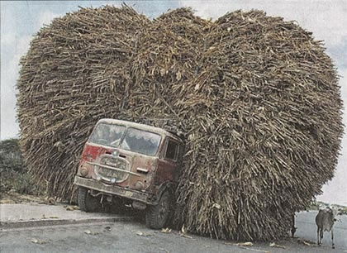
Where am I going to find the time and energy to add one more thing?

Slide 21
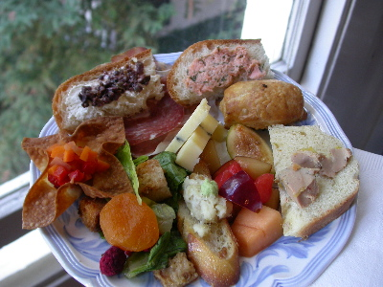
My plate is already full!

Slide 22

Character is the plate!
Notes:
Think of the fact that CC! gives time – not taking time

Slide 23

MODULE 2
School Improvement Through CHARACTER COUNTS! 6.0

Slide 24
Character is the Decisive Ingredient of Success
Research in psychology, economics, education and neuroscience have coalesced toward one important conclusion: the non-cognitive qualities of perseverance, conscientiousness, optimism, curiosity and self-discipline (all of which can be included under the general category of `character’ ) are more likely to produce success than a high IQ and highly developed cognitive skills.

Slide 25
A substantial body of research demonstrates that a positive school climate effectively increases academic performance, social/emotional and character development and improved conduct.
So, the basis of CHARACTER COUNTS! 6.0 is establishing a positive school climate.
“Devoting class time to these skills is a more effective way to increase academic achievement than spending all your time on the academic content itself.”
-- Richard Roberts
Notes:
Richard Roberts: http://www.nnstoy.org/wp-content/uploads/2013/07/Roberts-Noncogs-in-K12.pdf
http://asiasociety.org/files/A_Rosetta_Stone_for_Noncognitive_Skills.pdf

Slide 26
Research studies have shown that character education does work in bringing about a change in school culture and in improving student behavior.
Decline in:
Disciplinary referrals
Suspensions and expulsions
Drop-out rates
Improvement in:
Attendance
Report card grades
Standardized test scores
Rutgers Center for Social and Character Development

Slide 27
Success Super Powers: Self-Discipline, Perseverance and Positivity
Self-discipline and diligence are qualities that produce all sorts of positive life outcomes:
Less likely to abuse drugs and alcohol
Less likely to get in trouble with the law
More likely to create and maintain healthy relationships (including getting and staying married)
Similar results have been found regarding the personality traits of perseverance (or grit), curiosity and optimism.
Conscientiousness (diligence) is a better predictor of a student’s eventual success in college, and in future earnings, than their scores on cognitive tests.
Scores on self-discipline tests predict college GPA’s better than IQ scores.

Slide 28

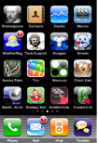
“Imagine academic skills as apps for an iPhone. Non–cognitive skills are the operating system for the iPhone itself. You might not need them to memorize state capitols or do twenty addition problems in one minute. But to do the kind of research built into the Common Core Standards, or to take on the engineering design challenges involved in STEM curricula, kids need to develop perseverance, collaboration, and other non–cognitive skills.” - Justin Minkel
Notes:
Justin Minkel - http://blogs.edweek.org/teachers/teaching_for_triumph/2013/10/true_grit.html

Slide 29
Josephson Institute Model Standards
16 Core Standards
6 Indicators of a Positive School Climate
100 Critical Educational Outcomes
THE FOUR WHEELS OF SUCCESS
Academic, Social & Emotional, Character and School Climate
THIS IS THE PLATE!

Slide 30
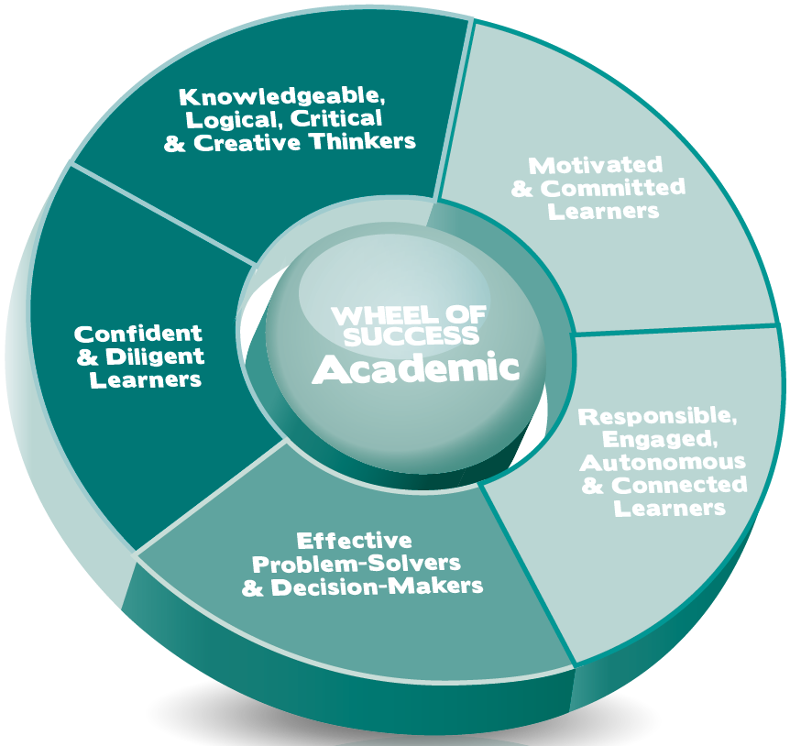

Slide 31
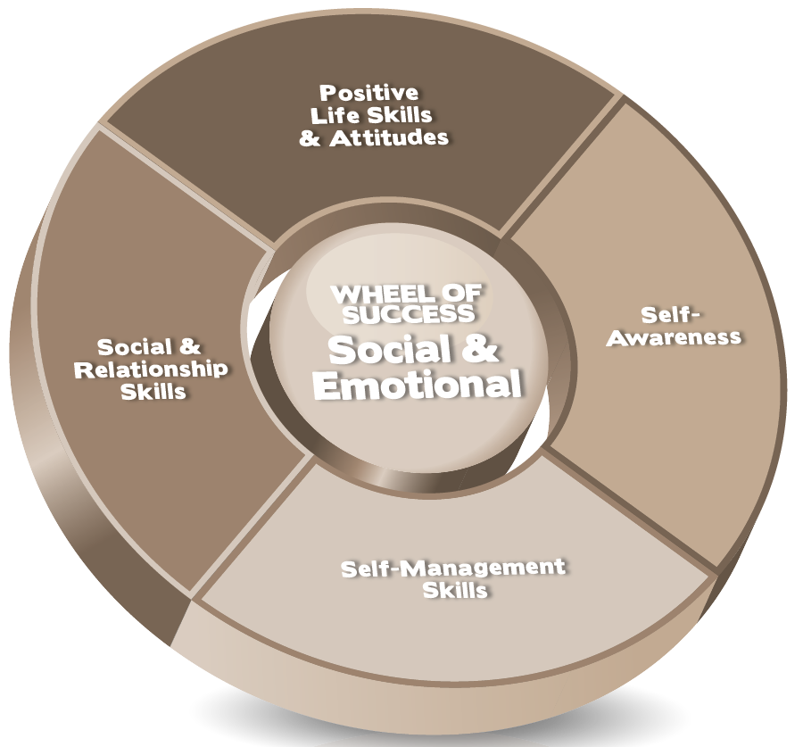

Slide 32
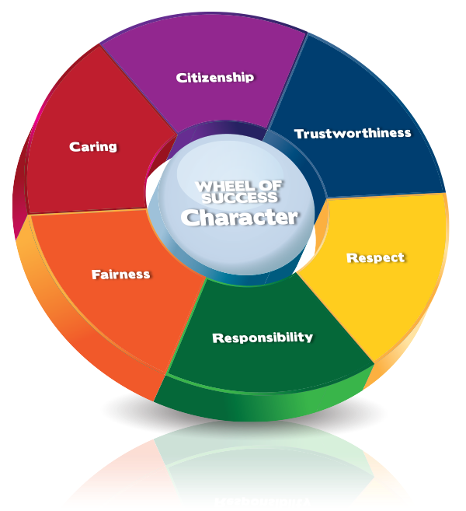

Slide 33
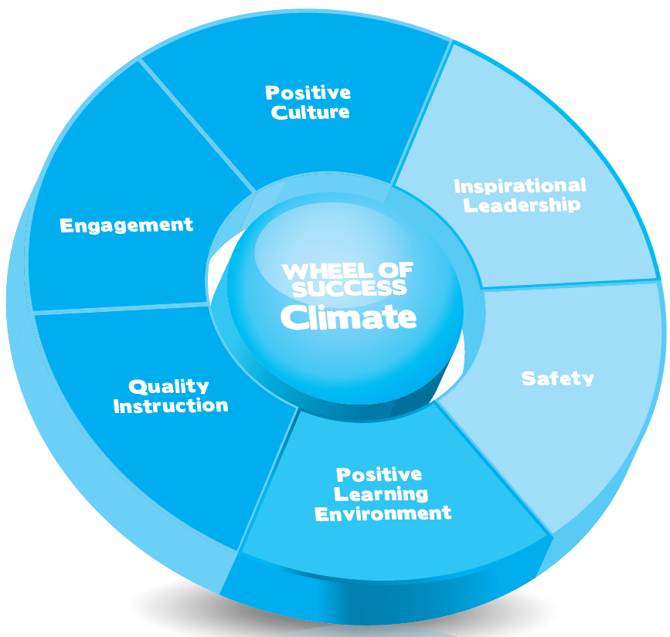

Slide 34
The Problem –
Building the Case
What would you like to see more of or less of in the four domains on the part of students, staff and parents?
GROUP 1 GROUP 2 GROUP 3
Completes: Completes: Completes:
• ACADEMIC • SOCIAL/EMOTIONAL • CLIMATE
• CHARACTER • CHARACTER • CHARACTER
Worksheet 6 – Page 13
Notes:
Use this slide as a template and create 4 slides maximum to cover results of the participants’ pre course survey.
You will have been sent a live link to the specific CDS you are facilitating. This will be a live link, which means you can access the results before the class begins.

Slide 35
Defining Elements of CHARACTER COUNTS! 6.0
FOUR WHEELS OF SUCCESS
MODEL STANDARDS & MATRIX
COMMON LANGUAGE: Six Pillars & Six Success Skills
T.E.A.M.- TEACH, ENFORCE, ADVOCATE, MODEL
BEST POSSIBLE RESULT (BPR) DECISION-MAKING
KEY & LOCK BELIEFS
MODEL FOR MINDSETS AND CHANGE

Slide 36
SIX PILLARS OF CHARACTER
SIX SUCCESS SKILLS
Trustworthiness
Respect
Responsibility
Fairness
Caring
Citizenship
Self-Discipline
Resilience
Diligence
Perseverance
Positivity
Learning

Slide 37

TRUSTWORTHINESS - You can trust me because:
I tell the truth
I am honest and don’t cheat or steal
I do the right thing even when it’s hard
RESPECT - I am respectful because:
I follow the "Golden Rule”
I value and accept everyone without prejudice
I don’t bully anyone
RESPONSIBILITY - I am responsible because:
I think before I act
I take responsibility for what I say and do
I always do my best

Slide 38

FAIRNESS - I am fair because:
I play by the rules
I think about how my conduct affects others
I don't take advantage of others
CARING - I am caring because:
I am kind
I help others when they need it
I pay attention to the feelings of others
CITIZENSHIP - I am a good citizen because:
I obey laws and rules
I help make the school and community better
I protect the environment

Slide 39

SELF-DISCIPLINE – I show this by:
Making sure my behavior is appropriate and reflects my values
Understanding that just because I feel like doing something doesn’t mean I should, or that I have to do it
RESILIENCE – I show this by:
Bouncing back from difficulty or failure
Accepting the fact that even when life is tough, I know I can survive.
DILIGENCE – I show this by:
Doing my best work in all I do because it is worth it
Realizing that I might not be the best, but I will try to be the best me

Slide 40

PERSEVERANCE – I show this by:
Being able to resist temptations and pressures to give up or quit
Choosing to persist as long as I am able
POSITIVITY – I show this by:
Having a positive outlook that can help me accomplish positive results
Understanding how having a negative attitude can affect my happiness
Choosing to find a positive alternative
LEARNING – I show this by:
Learning new things so that I can continue to grow and develop
Focusing and understanding that learning is up to me
Understanding the mind is a muscle that gets stronger with use

Slide 41
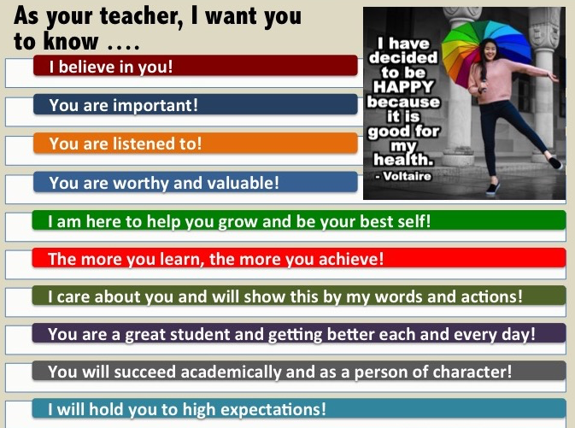
When students feel liked and respected by their teachers, they find more success in school, academically and behaviorally.

Slide 42
Video Lesson
I Believe in You
Notes:
The video link was active at the time of the seminar. Please understand that links can change or no longer be active.
https://www.youtube.com/watch?v=T_i34m981-Y

Slide 43
SPECIFY: Make clear the values & traits you want students to learn.
DEFINE: Make sure students understand what it means in terms of their behavior.
APPLY: Use the language consistently and continuously.
Confer appropriate positive and negative consequences, with consistent application and monitoring.
T.E.A.M.
Teach
Enforce
Advocate
Model
Communicate clearly and intentionally the importance your school attaches to character and the traits you want to instill. Make sure you are not neutral about the importance of good character.
Be self-conscious about setting a good example in what you do and say.
Notes:
Give examples of Teaching:
Language Arts: The students read a story, legend or myth, then write an analysis of the most strongly exhibited value. Character trait in the work studied—How is this pillar revealed and by whom?
Social Studies: Current events/historical event involving some type of conflict—discuss/debate/present/write/research Pillars involved/tested/needed.
Science: Current event/scientific problem/issue or discover/invention. Students discuss/write/present. Search/debate the character implications connected to this problem.
Integrated character education with other subjects/cooperate with colleagues to address character issues that span academic subject areas.
Service-learning
Provide opportunities for students to engage in meaningful opportunities to meet needs in the community.
Give examples of Enforcing:
Classroom rules/expectations
Consistency/Fairness
Consequences—positive and negative
Give Examples of Advocate:
Encourage faculty, staff, students, parents and community members to think about the Six Pillars and their importance.
Participate in opportunities to promote the initiative in your building or in the community.
Take the message to everyone
Give Examples of Model:
Just Do It
“The only true remaining freedom is our ability to choose our attitude in any given situation” (Victor Frankl)
Make your attitude worth catching
Say what you mean and mean what you say
Everything you do and say sends a message—what message are you sending?

Slide 44
Effective
Ethical
Best Possible Result
Outcome:
Decision-Making
Notes:
Just an introduction to Decision-making. More on Day 2 with activities. Make sure you refer to stakeholders, choices, potential consequences and BPR when reviewing video clips.

Slide 45
CHARACTER COUNTS! 6.0
Social & Emotional Learning
Whole Child
Growth Mindset
Anti-Bullying / Pro-Kindness
Character Development
Change Theory
Critical Thinking
Common Core
Climate and Culture
21st Century Student Outcomes
CHARACTER COUNTS! 6.0 has drawn from the research supporting and the strategies advocated by each of these approaches to education.
Notes:
In the past decade a substantial number of theories have emerged and found there way into discussions and efforts for educational reform. Each of these theories offers some valuable insights regarding the goals of education and methods of achieving those goals.
For the most part these diverse theories are compatible but they focus on different issues and aspects of the problem.
CHARACTER COUNTS! 5.0 is the result of a very deliberative and conscientious effort to integrate the best discoveries and insights of each theory within one comprehensive overarching strategy.
At the center of CHARACTER COUNTS! 5.0 is the foundational premise of CHARACTER COUNTS! since it’s inception – attaining meaningful, measurable and sustainable changes in behaviors and beliefs requires the creation of a culture or climate that promotes the development of core ethical values and character traits (the Six Pillars of Character) and positive life skills and attitudes.
Thus, there are important elements of each of the theories highlighted in the above graphic.

Slide 46
KNOWLEDGE
Facts, Concepts, Theories
Methods, Techniques, Processes
SKILLS
Abilities
Competencies
BELIEFS and VALUES
Values, Convictions
Attitudes, Mindsets
TRAITS OF CHARACTER
Qualities, Dispositions
Attributes, Characteristics

Slide 47
MEANINGFUL
MEASURABLE
SUSTAINABLE
CHARACTER COUNTS!® instructional strategies should deal effectively with issues that are relevant and are intentionally taught.
CHARACTER COUNTS!® should show effectiveness with measurable changes in attitudes and conduct.
CHARACTER COUNTS!® becomes part of the DNA of a school, organization or community, so that values promoted endure changes in programs, curriculum, leadership or staff.
Notes:
Focus on Meaningful, Measurable, and Sustainable.

Slide 48
MODULE 3
Principles of Change and Mindsets
Principles of Change
Changing Behavior by
Changing Beliefs
Notes:
How do we change our perceptions?
By changing our behavior through changing our beliefs (essentially our values).

Slide 49
Goal: improve society and the lives of children by improving their values, character and behavior.
Improvement is positive change.
Most effective way to change someone: instill or strengthen values that determine choices.
Notes:
Ask:
Can we really change entrenched behaviors and attitudes that have become part of the culture?
Can you change the culture?
Answer: yes. Show the slides that indicate reductions in tobacco use and point out that this reduction came about in part through a dedicated effort to change beliefs about smoking. Remember when smoking was thought of as glamorous? And now? Not so much!

Slide 50
CHARACTER COUNTS! is about Change
The idea of changing the character of an individual or the culture of an organization is so daunting that it sometimes doesn’t seem possible.
Changing beliefs is much more doable.
CHARACTER COUNTS! instills or strengthens positive beliefs that promote desirable behaviors and modify or replace negative beliefs that support undesirable behaviors.
An effective CHARACTER COUNTS! implementation embeds positive values (beliefs) into the DNA of individuals and their institutions.
Notes:
Read the slides.

Slide 51
Change theory as a key student development strategy
All growth, including acquiring new information, skills, and traits, is change.
Growth occurs when a student replaces beliefs and attitudes that limit academic growth or character development with beliefs promoting behaviors that create success.
The best way to improve a student’s life is to change their behavior by changing beliefs and attitudes.
It is a challenge to replace a strongly held belief, a mindset, or attitude, with a new belief, attitude or approach.

Slide 52
“If you want to change the world, you eventually have to change how people behave.”
“And if you want to change how they behave, you have to first change how they think.”
Influencer: The Power to Change Anything” (2010)
Notes:
Refer briefly to Influencer.

Slide 53
Behavior is the result of values, beliefs, mindsets and attitudes that dictate our actions.
We possess many beliefs and attitudes that we did not choose – they came from parents or other social and cultural forces, and adopted without much reflection.
A primary goal of education is to develop critical thinking skills so that we exercise more control over choices and make decisions based on reason and logic rather than instinct and emotion.

Slide 54
Our attitudes and mindsets affect our actions and reactions
We may not choose our immediate emotional reaction or initial attitude but we can choose to hold on to or change how we react to or feel about a situation

Slide 55
Video Lesson
Empathy: The human Connection
Notes:
The video link was active at the time of the seminar. Please understand that links can change or no longer be active.
https://www.youtube.com/watch?v=T_i34m981-Y

Slide 56
Insights About Change
Knowledge does not change behavior; must reach the emotions
Simplify and narrow the choices
Set specific and concrete behavioral goals
Go for easy and early successes
Use stories, visual images, simulations and hands-on experiences

Slide 57
Questions Related to Change
What will success look like?
Is it worth it?
How do I do it?
What needs to change?
What will make it work?
I can do it!
We did it!
Vision
Professional Development
Resources / Strategies
Action
Plan
Lasting Results
Commitment
Assessment

Slide 58
Facilitating Change for a Meaningful, Measurable, Sustainable Initiative
Vision
Commitment
Professional Development
Assessment
Resources
Action
Plan
Lasting
Results

Professional Development
Resources
Action
Plan
Confusion
Commitment
Assessment

Professional Development
Action
Plan
Sabotage
Vision
Assessment
Resources

Resources
Action
Plan
Anxiety
Vision
Commitment
Assessment
Assessment
Professional Development

Resources
Action
Plan
Uncertainty
Vision
Commitment
Professional Development

Action
Plan
Vision
Commitment
Assessment
Frustration
Vision
Commitment
Professional Development
Resources

False Starts
Assessment
If any factor is missing, a meaningful, measurable, sustainable change will not happen.
Adapted from Knoster, T., Villa, R., & Thousand, J. (2000). A framework for thinking about systems change
Notes:
For a successful CC! initiative that is meaningful, measurable and sustainable, a change in how a staff thinks and behaves must be seriously considered. The successful initiative needs 6 key elements to produce lasting results:
Vision
Commitment on the part of staff
Professional development or training
Assessment
Resources for teachers to integrate CC! into the curriculum
Action Plan
If any factor is missing, a meaningful, measurable, sustainable change will not happen.
This change chart will also help in Day 3 with the development of action plans.

Slide 59
People will not change entrenched attitudes or behaviors unless they believe two things:
IT’S WORTH IT
It’s worth the effort
What I will get is more valuable than what I give up
I CAN DO IT!
Notes:
Remind participants that the goal of change is to convince people that they can do it and that change is worth it. This is a theme that will flow through the three days and we hope you will find ways to convince your students and other stakeholders to have the confidence to realize that things don’t stay the same and that positive change is worth making.

Slide 60
Video Lesson
Arturo Alvarez
Notes:
An alternative to the video clips from Pay It Forward. A story from “In Search of Character.” This clip speaks directly about change in a young person’s behavior because he believed it was worth it and then he sets forth a direction to change his life.

Slide 61
CHARACTER COUNTS! can change the entire climate of a school, organization, or community
Improvement in academic achievement
Reduction in misbehavior and crime
Increased attendance
Improvement in school climate

Slide 62
Mindsets and Perceptions
The Best Way to Change Your Life is to Change Your Attitude

Slide 63
What is a Mindset
A habitual or characteristic mental attitude or an inclination or disposition that influences or determines a person's responses to and interpretations of situations.
If you refer to someone's mindset, you mean their general attitudes and the way they typically think about things.

Slide 64
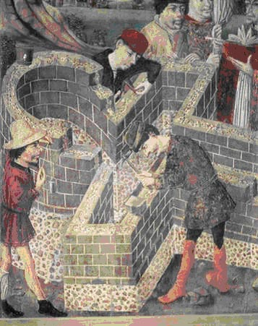
If you change your perspective, you change the way you experience the world
Three stonecutters were asked what they were doing.
  The first man replied: “I am making bricks from this stone.”
  The second said: “I am making the foundation for a building.”
  The third answered: “I’m building a cathedral.”
So what? What difference does it make how a person looks at his/her work?
Notes:
Relate this to the school and organizational systems the participants are involved in. What might a cathedral building teacher say? What might a brick-maker teacher say?

Slide 65

Do you see the arrow?
Notes:
Most people never say the arrow but once you point it out they will never miss it again.
There are many things that are in front of us, that have always been there that we never see.
There are ethical aspects of situations, other facts and points of view that we did not see.

Slide 66
Do you see the arrow?
Character & Ethics
Not seeing meaning in the white space is a mindset
Notes:
Most people never say the arrow but once you point it out they will never miss it again.
There are many things that are in front of us, that have always been there that we never see.
There are ethical aspects of situations, other facts and points of view that we did not see.

Slide 67

How many arrows are there?

Slide 68

What do you see?

Slide 69
Mindsets and Perception
What we see is affected by our vantage point and we often do not see all that is before our eyes
The brain adopts strategies and looks for patterns
What we see is not necessarily what is

Slide 70
Video Lesson
Life Without Limbs – Nick Vujicic
Notes:
The video link was active at the time of the seminar. Please understand that links can change or no longer be active.
https://www.youtube.com/watch?v=T_i34m981-Y

Slide 71
Mindset Choices That Change Your Life
MINDSETS
Ethics or expediency
Accountability or excuses
Judgmental or acceptance
Positive or negative
Growth or fixed

Slide 72
Most Powerful Mindsets
Positivity SE4.5
Growth A2.1
Ethics
C.1

Slide 73
Video Lesson
Special Athlete
Notes:
An alternative to the video clips from Pay It Forward. A story from “In Search of Character.” This clip speaks directly about change in a young person’s behavior because he believed it was worth it and then he sets forth a direction to change his life.

Slide 74
A2. CONFIDENT AND DILIGENT LEARNERS
Students are confident that with diligent effort they can learn what they need to know and develop the personal attributes they need to succeed in school and the workplace. (Instead of thinking, “I can’t”, they think, “I can’t . . . yet.”).
2.1 Growth Mindset
2.2
Learning From Mistakes
Students believe that with focused effort and diligent practice they can: Increase their basic intellectual abilities to master new and difficult concepts; develop life skills, personal attributes and moral virtues; adopt positive attitudes and reject negative emotions and mindsets.
Students learn from their mistakes and unsuccessful efforts, treating them as a part of the learning process rather than evidence of an inability to learn.
Notes:
From the Model Standards

Slide 75
Video Lesson
Growth Mindset
Notes:
An alternative to the video clips from Pay It Forward. A story from “In Search of Character.” This clip speaks directly about change in a young person’s behavior because he believed it was worth it and then he sets forth a direction to change his life.

Slide 76
FIXED MINDSET personal attributes (intelligence and talents) are inborn. “You either have it or you don’t.”
GROWTH MINDSET “You can do anything you put your mind to”; attributes and talents can be developed.
Never say “I can’t.” Say, “I can’t yet.”
Notes:
Fixed mindset
Assume they cannot do what they have not been able to do before
Identify what they are not good at
Give up easily
See effort as a waste of time
Ignore useful negative feedback
Feel threatened by the success of others
Growth Mindset
Embrace challenges
Persist in the face of setbacks
Sees effort as a path to mastery
Learn from criticism
Find lessons and inspiration in the success of others

Slide 77
Growth Mindset | Fixed Mindset
Math is hard for me but with work I can get better | I’m just no good at math. It’s a waste of time to try
It sometimes takes me longer to learn but I can | I’m just not smart enough
I can’t expect to succeed at everything right away | When I fail I stop trying because I know it is no use
I can learn something from every failure, mistake or setback | Every failure, mistake and setback, just proves that I can’t do this
I’m willing to try | Trying is a waste of time
If I try hard I know I can at least get better | No matter how hard I try I will never be good at this

Slide 78
Video Lesson
Susan Boyle
Notes:
An alternative to the video clips from Pay It Forward. A story from “In Search of Character.” This clip speaks directly about change in a young person’s behavior because he believed it was worth it and then he sets forth a direction to change his life.

Slide 79
Mindfulness
Mindfulness is noticing what is happening right now by taking notice of how your body feels and what you see, smell and taste.
Mindfulness is also noticing what your mind is doing.
When you notice what is happening around you, you focus more deeply, and that attention to your own senses will help you improve in many areas of your life.
It can help you to calm down when you’re sad, angry or frustrated.
Mindfulness helps you deal with tough emotions and can make you happy and feel good.

Slide 80
Benefits of Mindfulness
Scientific evidence suggests that mindfulness interventions:
Improve attention, self-control, and emotional resilience.
Strengthen our "mental muscle" for bringing focus back where we want it, when we want it.
Helps us recognize our emotions, when they occur, and to change how we respond to them.
Raise awareness of our own thoughts, emotions, and senses. This grows our understanding of what other people are experiencing.
Breathing and other mindfulness practices that relax the body and mind, giving access to peace independent of external circumstances.

Slide 81
Mindfulness for Students
It’s important for educators to provide age-appropriate mindfulness practices for children.
Mindfulness has been found to:
Mitigate the effects of bullying (Zhou, Liu, Niu, Sun, & Fan, 2016).
Enhance focus in children with ADHD (Zhang et al., 2016)
Reduce attention problems (Crescentini, Capurso, Furlan, & Fabbro, 2016).
Improve mental health and well-being.
Improve social skills when well taught and practiced in children and adolescents.

Slide 82
Emotional problems such as anxiety, stress and depression can affect self-esteem, performance and social interaction to a great extent in students. Recent findings suggest that mindfulness practice may facilitate the ability to manage stress and lead to improved well-being in students.
Mindfulness practice leads to higher scores on self-report measures of optimism and positive emotions in elementary school students. Moreover, in a study conducted by Wall (2005), self-reported findings showed children feeling calmer, and had an enhanced experience of well-being,

Slide 83
Students Social and Emotional Challenges
Experience greater pressures earlier in life
Feel more stress and anxiety than ever before
What if the school day began with a few moments of quiet and stillness?
Notes:
That’s why we’re launching The Calm Schools Initiative. We are offering every teacher in the world free access to Calm, the mindfulness app that hundreds of thousands of people all over the world use everyday. Our aim is to empower teachers with mindfulness tools and resources they can use to help kids learn this new skill.
Under this initiative, any teacher with a K-12 classroom, anywhere in the world, can get free access to Calm’s paid subscription service (available on Android, iOS and the web). If you’re a teacher, just take 30 seconds to fill out the simple form below, and you’ll be approved for The Calm Schools Initiative within a few days. Once you’re approved, we’ll send you some on-boarding resources to help you get started. We’ll share tips, suggestions, and best practices to introduce mindfulness to your classroom and get your students excited about meditation.
If you’re a parent or student, forward this page to your teacher and let them know how important mindfulness education is to you.
https://www.calm.com/schools

Slide 84
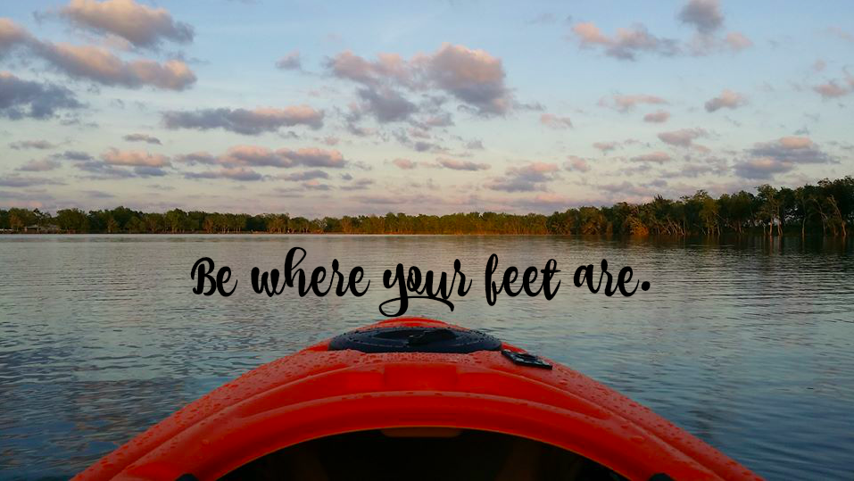
Mindfulness invites us to be in the moment without judgment, to unwrap the present.

Slide 85
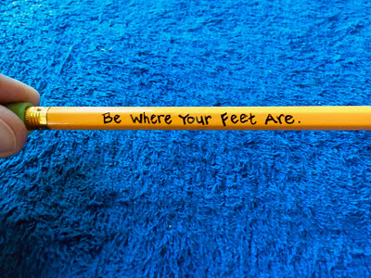
What’s your favorite
mindfulness mantra?
Invite students to write their mantra on their pencils so
calm is always at their fingertips.

Slide 86
7 Things Mindful People
Do Differently (Elisha Goldstein)
Approach everyday things with curiosity – and savor them.
Forgive their mistakes, big or small.
Show gratitude for the good moments and grace for the bad ones.
Practice compassion and connections.
Make peace with imperfection, inside and out.
Embrace vulnerability by trusting others and themselves.
Accept {and appreciate} that things come and go.

Slide 87
MODULE 4
Academic Wheel Of Success
Concerned with instilling academic knowledge and values that will help students to:
1) Succeed in school (including college or other post-secondary education)
2) Succeed in the workplace
3) Live happy, worthy and fulfilling personal lives,
4) Become engaged, responsible and productive citizens.

Slide 89
Model Standards in
Academic Wheel of Success
A4. Knowledgeable, Logical, Critical, Creative Thinkers.
A4.1. Acquire, Remember Knowledge.
A4.2. Understand Knowledge
A4.3. Apply Knowledge
A4.4. Analyze, Evaluate (Critical Thinking)
A4.5. Create, Innovate (Synthesis)
A4.6. Concentrate
A4.7. Perceptive and Observant
A4.8. Open-minded
A4.9. Intellectual Integrity
A4.10. Intellectual Independence
A4.11. Intellectual Humility
A4.12. Pursuit of Wisdom
A5. Effective Problem Solvers and Decision-Makers
A5.1. Rational Decision-Making Process
A5.2. Ethical Decisions.
A5.3. Effective Decisions
A5.4. Best Possible Result
A1. Motivated, Committed Learners
A1.1. Curiosity
A1.2. Personal Growth & Lifelong Learning
A2. Confident, Diligent Learners
A2.1. Growth Mindset
A2.2. Learning From Mistakes
A3. Responsible, Engaged, Autonomous, Connected Learners
A3.1. Dedicated to Education
A3.2. Fully Engaged in Learning Process
A3.3. Self-Directed
A3.4. Resourceful and Discerning Researchers
A3.5. Versatile Learners
A3.6. Connected to School Community
SUCCESS SKILL OF LEARNING
Notes:
The highlighted standards maybe the ones to focus on as a way of reducing the scope of the standards to a reasonable number that can be covered in the allotted time.

Slide 90
Success Skill of Learning
Students approach learning and other aspects of their lives with a growth mindset, believing they can: 1) Increase basic intellectual abilities; 2) Develop life skills that enhance success in all areas of their lives.
Students demonstrate personal responsibility for their education by becoming self-directed learners, fully engaged and connected to the school community.
Students believe in the importance and value of continuous self-improvement, personal growth and life-long learning. They demonstrate self-confidence in their ability to learn what’s needed and to develop the personal attributes to succeed in school.

Slide 91
Key Beliefs
It is important to keep learning new things so that I can continue to grow and develop.
It is up to me to focus and learn.
The mind is a muscle that gets stronger with use.
I will enjoy school more and be successful if I take charge of and participate in my own education.

Slide 92
Instructional Strategies
Make connections between the skills they are developing now and opportunities for future success.
Encourage students to develop proposals for their own extra credit projects on topics of interest.
Have an optional learning/reading center that students can access.
Show students that they already are life-long learners, learning new things every day.
Focus praise on effort and improvement rather than grades or natural abilities.
Choose content that is relevant to students.
Create opportunities for students to interact with others who they may not otherwise associate.
Teach strategies to help students focus, such as taking deep breaths or jotting down or visualizing a goal.

Slide 93
How To Promote Success Skill of Learning in the Academic Domain
Table 1-2 Personal Growth & Learning (A1.2) Growth Mindset (A2.1) (pgs. 2-3)
Table 3-4 Fully Engaged in Learning Process (A3.2) Connected to School Community (A3.6) (pgs. 4-5)
Table 5-6 Knowledgeable, Logical, Critical, Creative Thinkers (A4) Ethical Decisions (A5) (pgs. 7 & 9-10)
Using the Matrix
As a group:
Identify at least three reasons why teaching the skill is important.
For each strategy shared, determine if this reflects T – teaching E – enforcing A – advocating M- modeling.
Share at least 4 specific strategies to teach the skill.
What are the key beliefs you would like to instill in students?
In pairs, discuss a Way To Go lesson responding as to how you think your students would answer the questions.
44
Worksheet 7 – Page 22
Notes:
Review the Academic Wheel of Success. Refer participants to their copy of The Model Standards
• Assign the following to table groups:
T& R -Personal Growth & Learning ; Growth mindset (pg. 2)
R & F – Full Engagement in Learning Process(pg. 4); Connection to School Community
C & C – Critical Thinking (pg. 7); Ethical & Effective Decision-Making
As a group:
Identify at least three reasons why teaching the skill is important
What are the key beliefs you would like to instill in students?
Share at least 4 specific strategies to teach the skill
For each strategy shared, determine if this reflects T – teaching E – enforcing A – advocating M- modeling.

Slide 94
MODULE 5
Promoting a Positive School Climate

Slide 95
Creating a Positive and Safe Values-Based School Climate and Culture
What is school climate?
Why is it important?
Nurtures personal growth
Conducive to learning
Students are and feel physically and emotionally safe
Promotes healthy lifestyles

Slide 96
Indicators of a Positive School Climate
School Climate
Positive Culture
Engagement
Quality Instruction
Inspirational Leadership
Safety & Positive Behavior
Positive Learning Environment
Notes:
A detailed look at each of the indicators in found in the Model Standards. Specific action steps will be discussed as part of implementation.

Slide 97
Video Lesson
Every Opportunity
Notes:
An alternative to the video clips from Pay It Forward. A story from “In Search of Character.” This clip speaks directly about change in a young person’s behavior because he believed it was worth it and then he sets forth a direction to change his life.

Slide 98

Share a story about a positive school climate that you have experienced. What do you think made it a positive place for students and staff?
Share a story about a negative school climate that you have experienced. What do you think made it a negative place for students and staff?
Review the indicators of a positive school climate. Why do you believe these will make a difference in a school environment?
Worksheet 8– Page 23

Slide 99
Thank you for your outstanding work today. As you reflect on the day:
What was significant for you?
What surprised you?
What do you plan to do differently with your learning from today?
Reflections and Homework
Homework in preparation for Day 2:
Complete the Six Pillars Personal Inventory on pages 24-25.
Notes:
Ethics in Public Administration
(c)2006 Josephson Institute
99

Slide 100

CHARACTER COUNTS! is a project of
CHARACTER COUNTS! and the Six Pillars of Character
are trademarks of the Josephson Institute.

